Slide 1

Established November 2016
Vision: We envision a world in which all communities have the courage to dream, skills to build, and resources to own their future.
Mission: Develop economically sustainable and socially engaged Black communities
4 Pillars of Equitable Development
Equity for Black Youth, Black Businesses, Residents & Real Estate in Black Communities
Notes:
tackling the vacant home epidemic plaguing our region through large scale developments in underserved communities transforming once divested neighborhoods into thriving communities while employing black youth and minority contractors creating workforce development and scaling minority owned contracting businesses. Additionally, our development efforts will fight against displacement of current residents by providing renovation for seniors and grant dollars to support property tax concerns. At-risk youth will access a diverse and broad set of assets through mentorship, entrepreneurship, scholarship, and leadership training. Access to these assets will provide these youth with the necessary skills to succeed academically and professionally, and attain ownership in the development of low-income/highly distressed communities.t home epidemic plaguing our region through large scale developments in underserved communities transforming once divested neighborhoods into thriving communities while employing black youth and minority contractors creating workforce development and scaling minority owned contracting businesses. Additionally, our development efforts will fight against displacement of current residents by providing renovation for seniors and grant dollars to support property tax concerns. At-risk youth will access a diverse and broad set of assets through mentorship, entrepreneurship, scholarship, and leadership training. Access to these assets will provide these youth with the necessary skills to succeed academically and professionally, and attain ownership in the development of low-income/highly distressed communities.

Slide 2
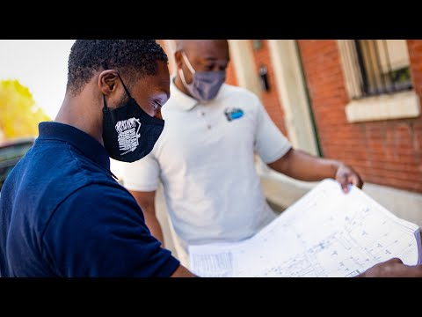
Dream Builders 4 Equity

Slide 3
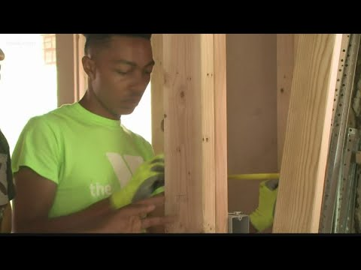
KSDK News ft. Dream Builders 4 Equity

Slide 4
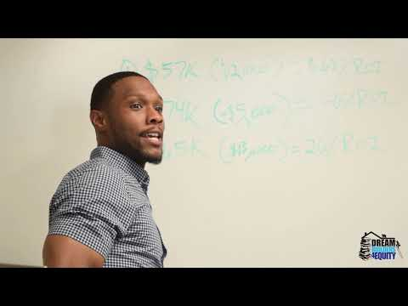
Summer Academy

Slide 5
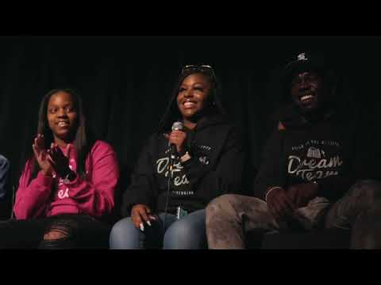
Dreams Made Real: Book Signing & Poetry Slam

Slide 6
Completed Home Rehabs

Slide 7
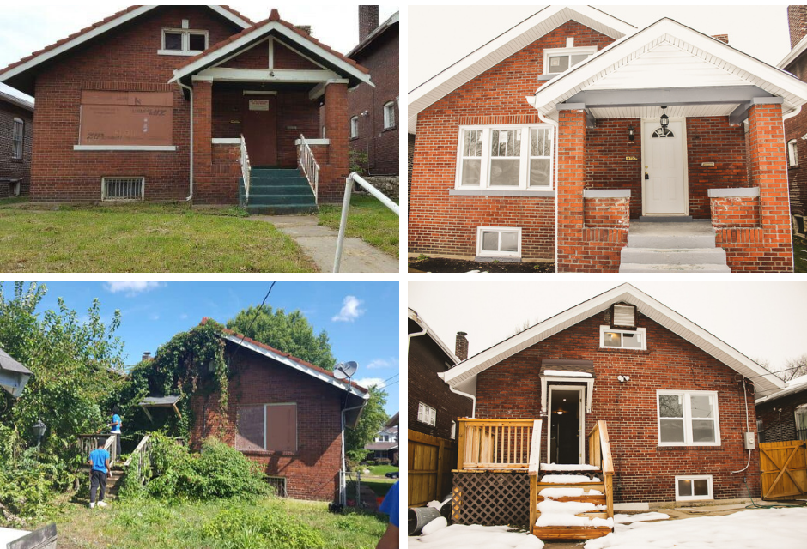
Lewis Place
Notes:
Vacant nuisance property acquired by DB4E in 2018
Completed rehab in 2019
Sold to first time homeowner for $80K
15 youth received a total of $15K for the sale of the property
Employed youth made $9/hour while working on the property alongside our minority contractors

Slide 8
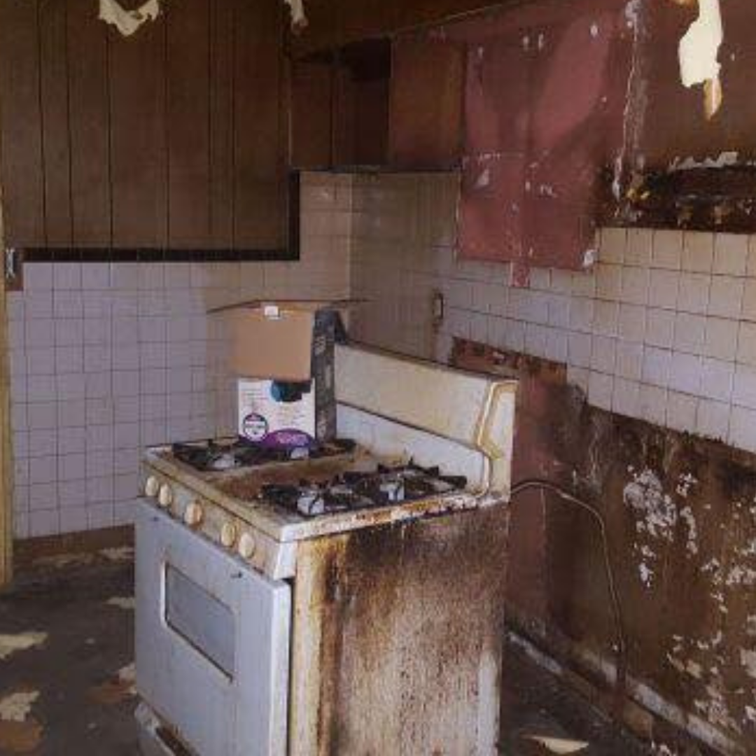
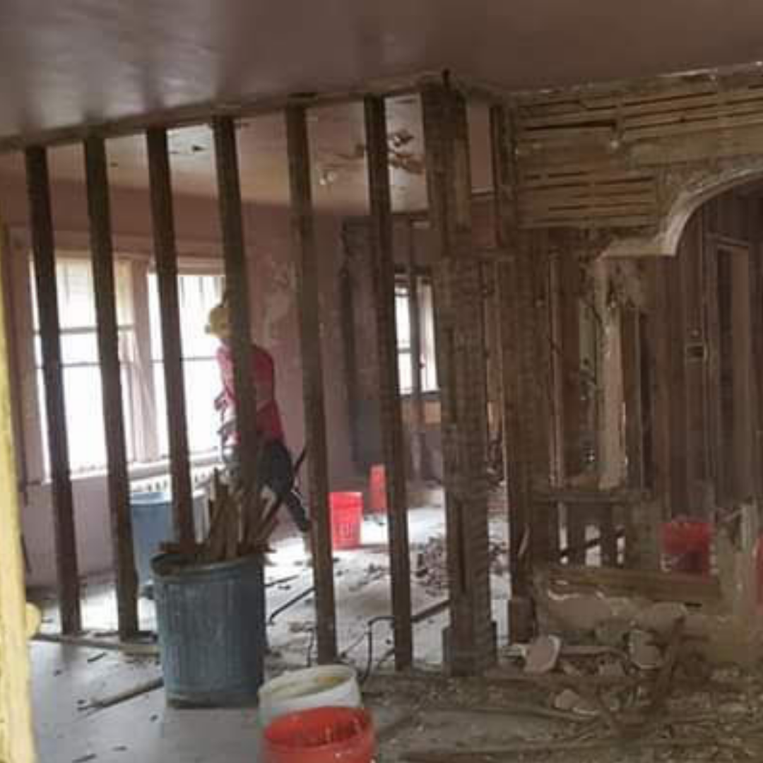
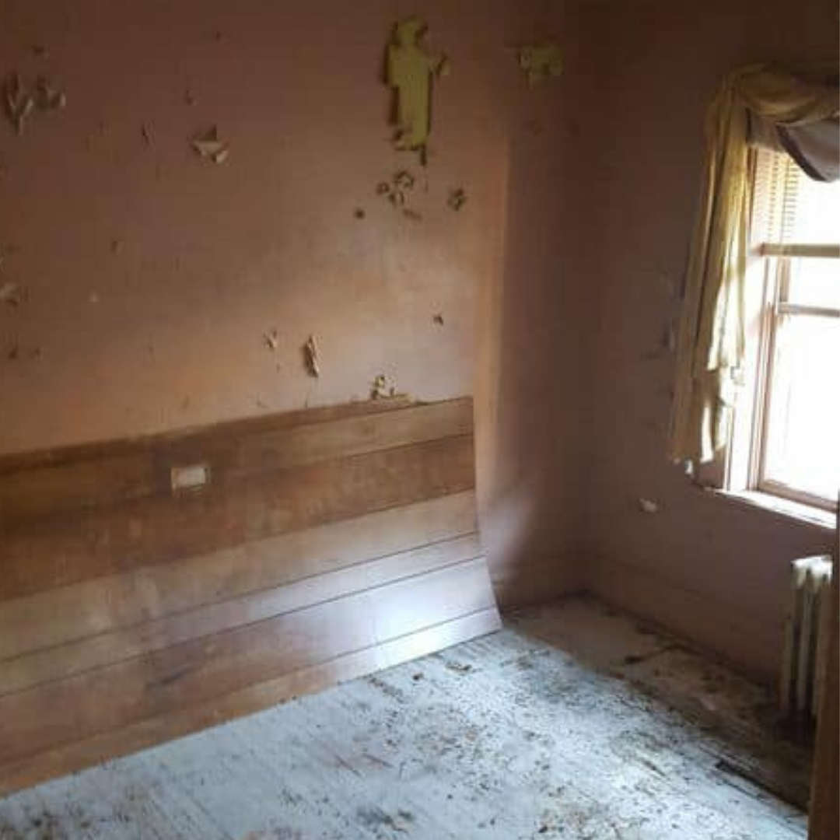
Lewis Place - Before

Slide 9
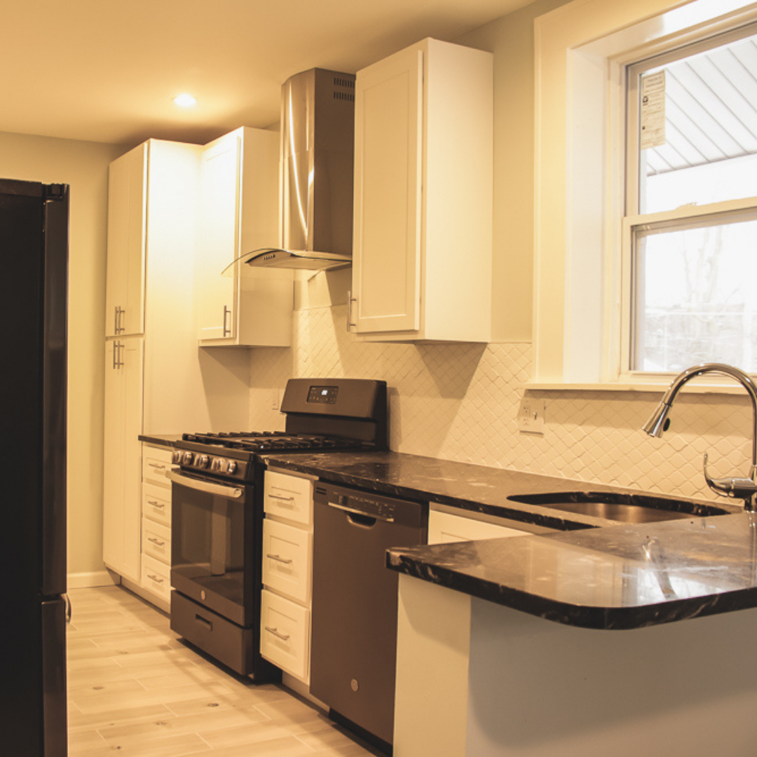
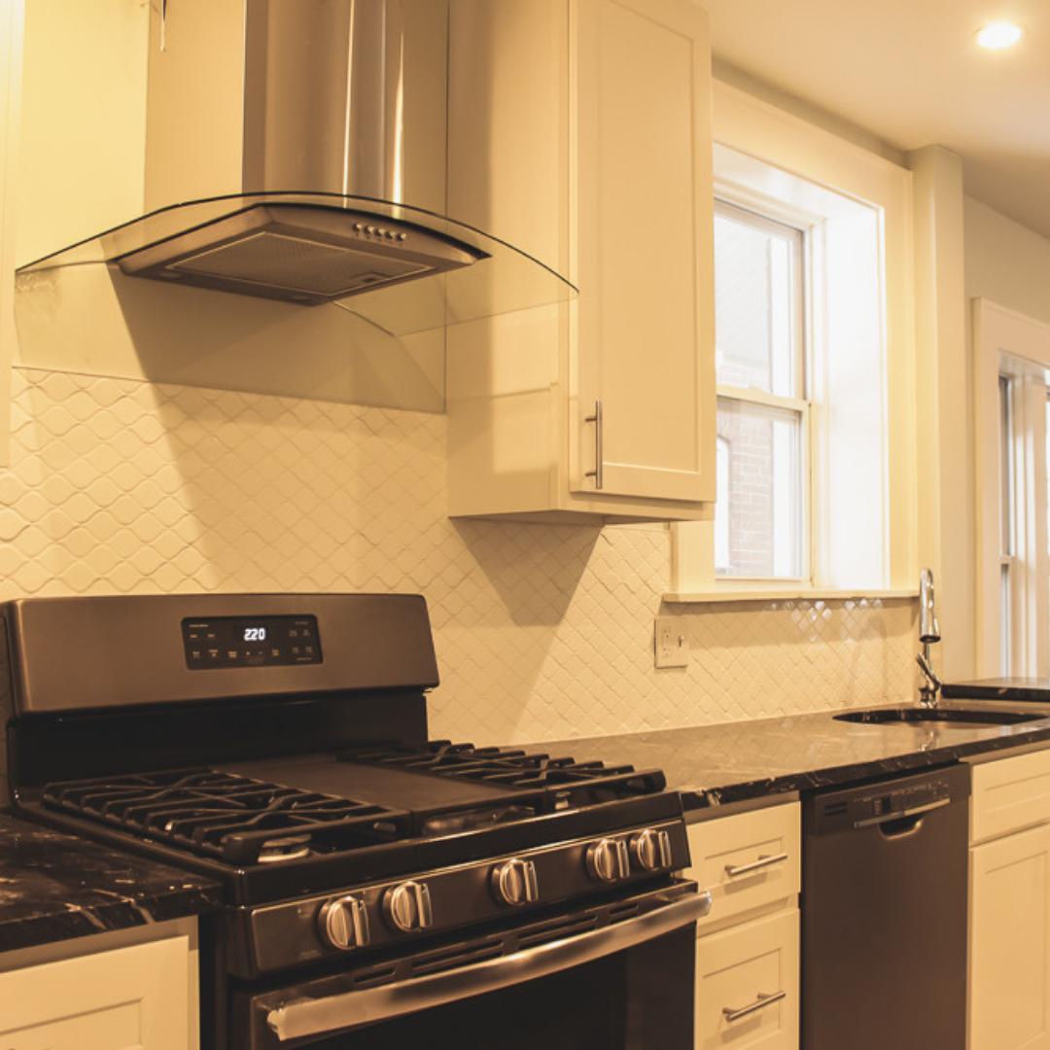
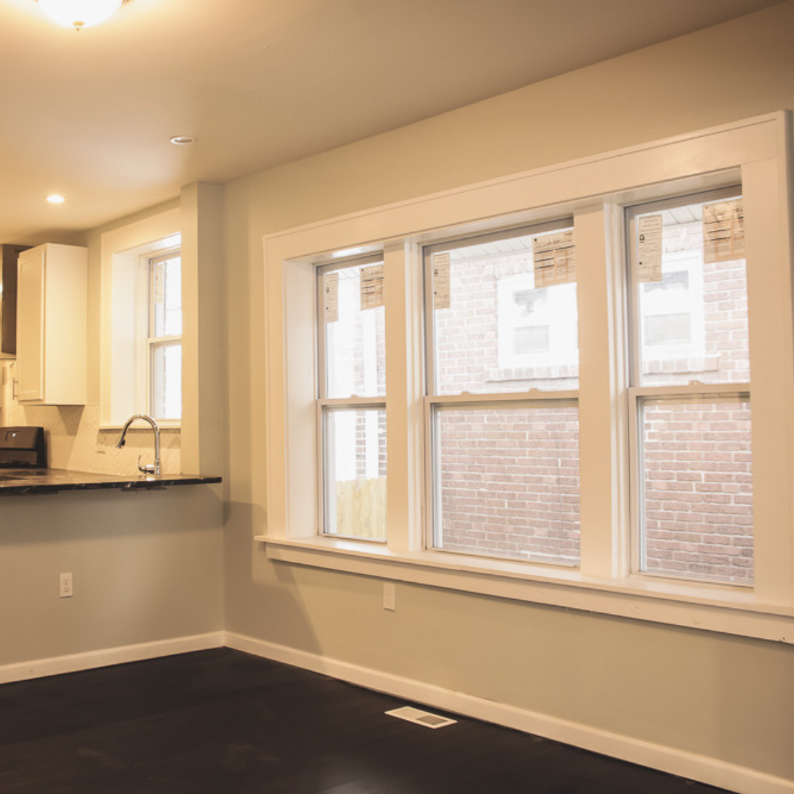
Lewis Place - After

Slide 10
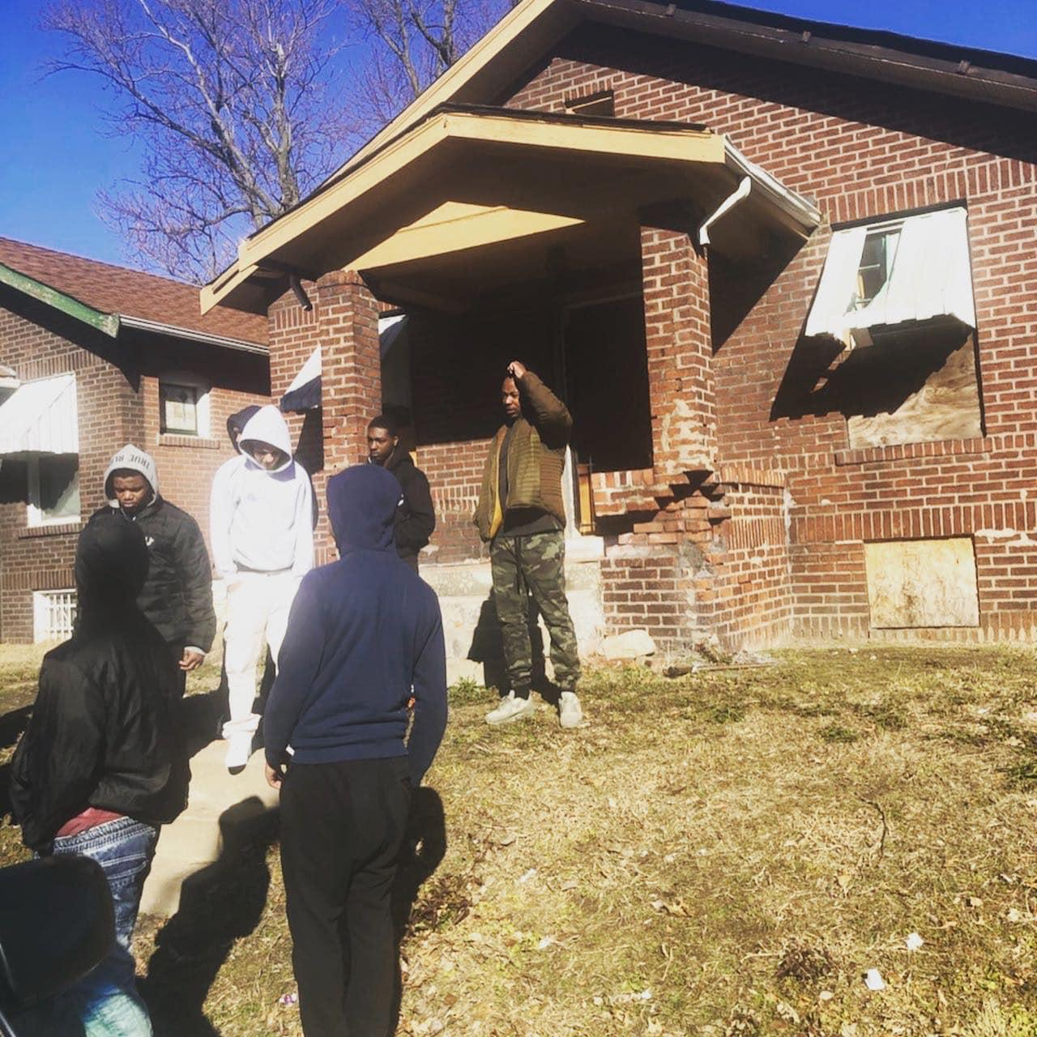
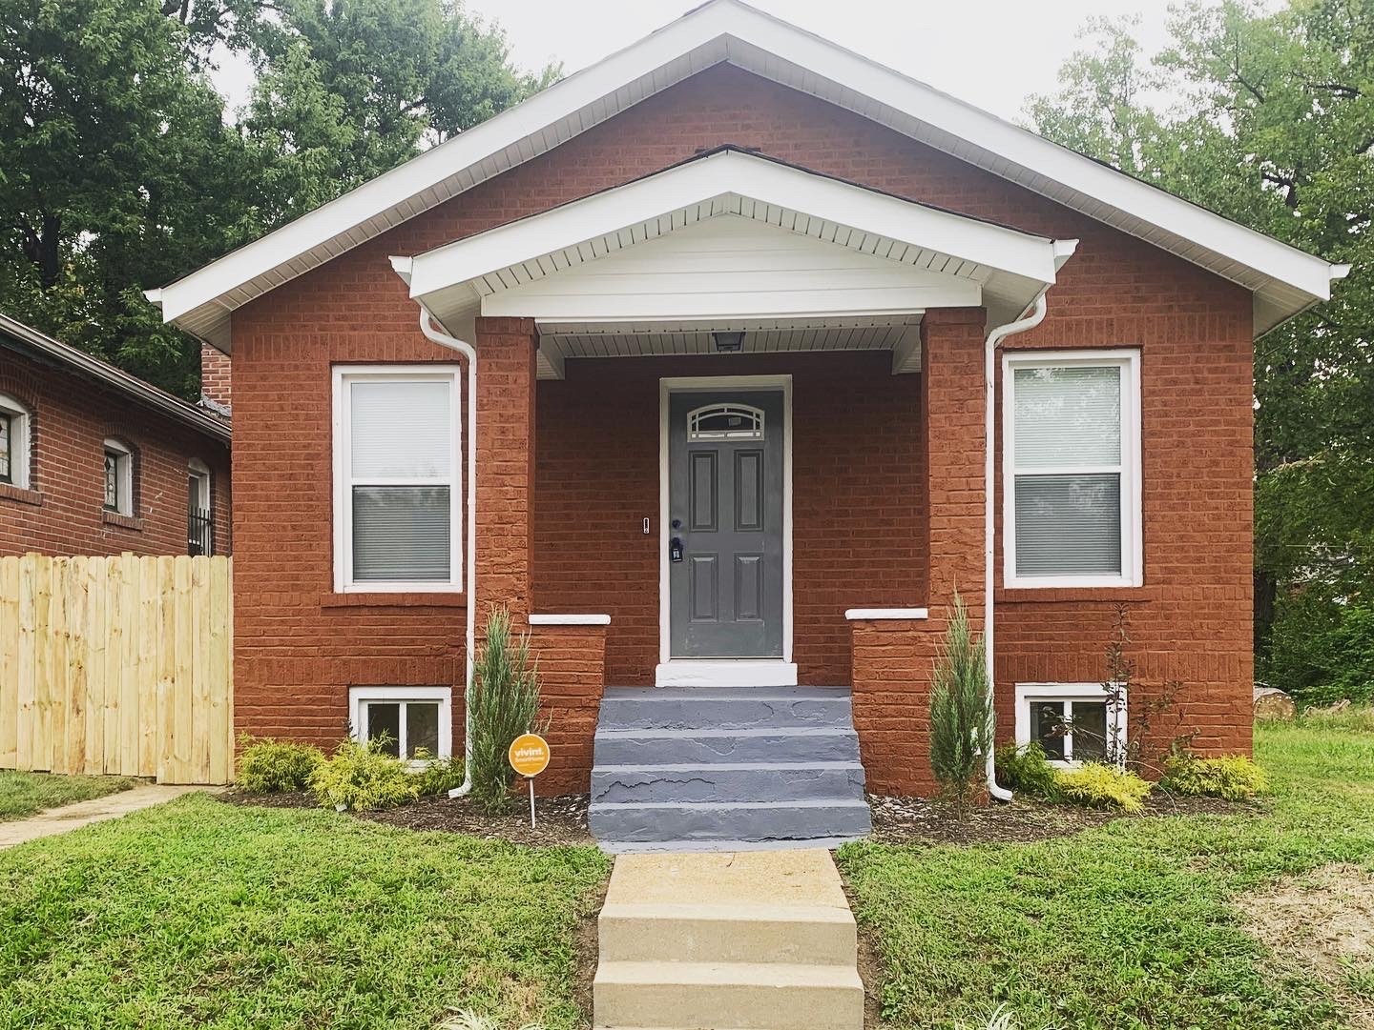
Cupples Place
Notes:
Vacant nuisance property purchased my DB4E in 2019
Completed rehab in 2020
House is on the market for $75K
15 youth are expected to receive $15K from the sale of the property
Employed youth made $9/hour while working on the property alongside our minority contractors

Slide 11
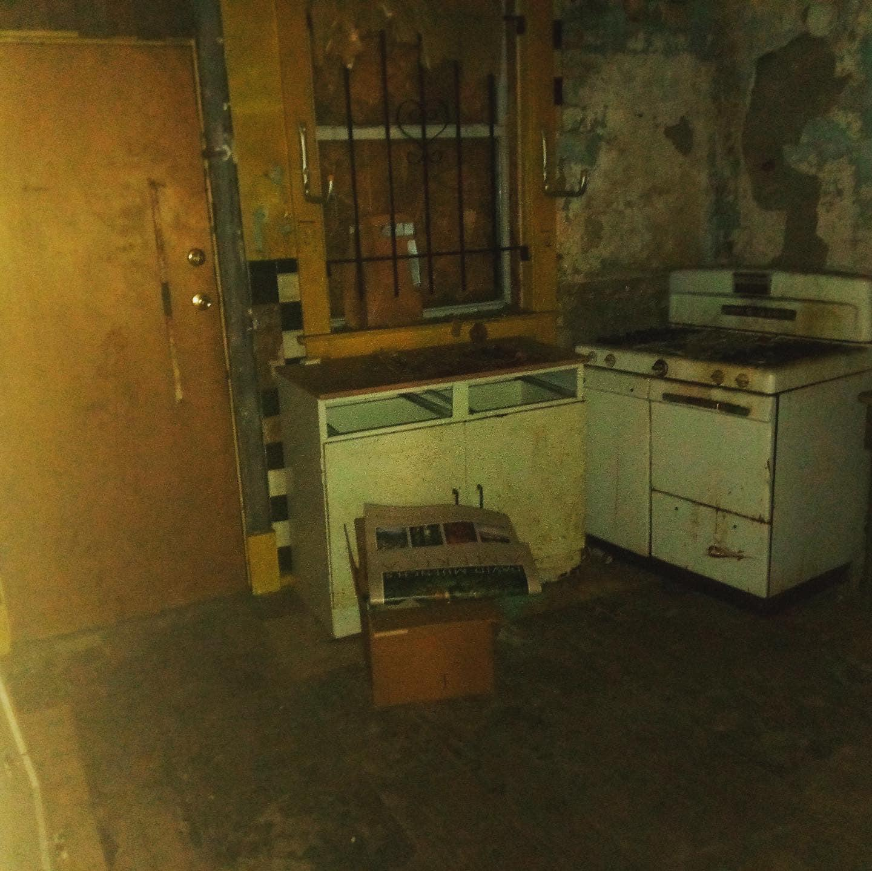
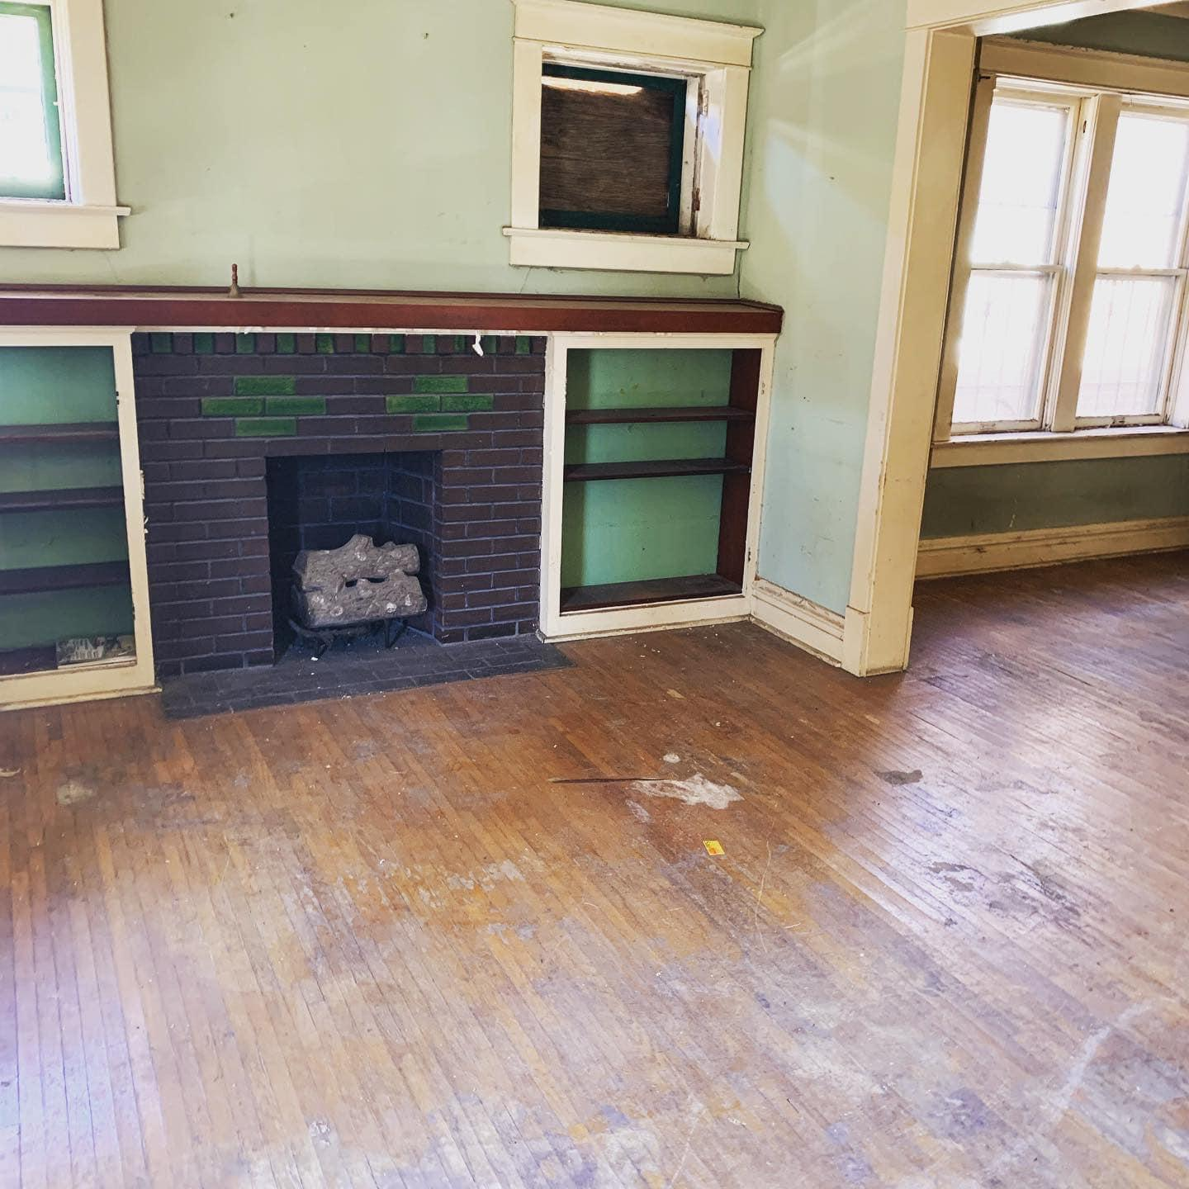
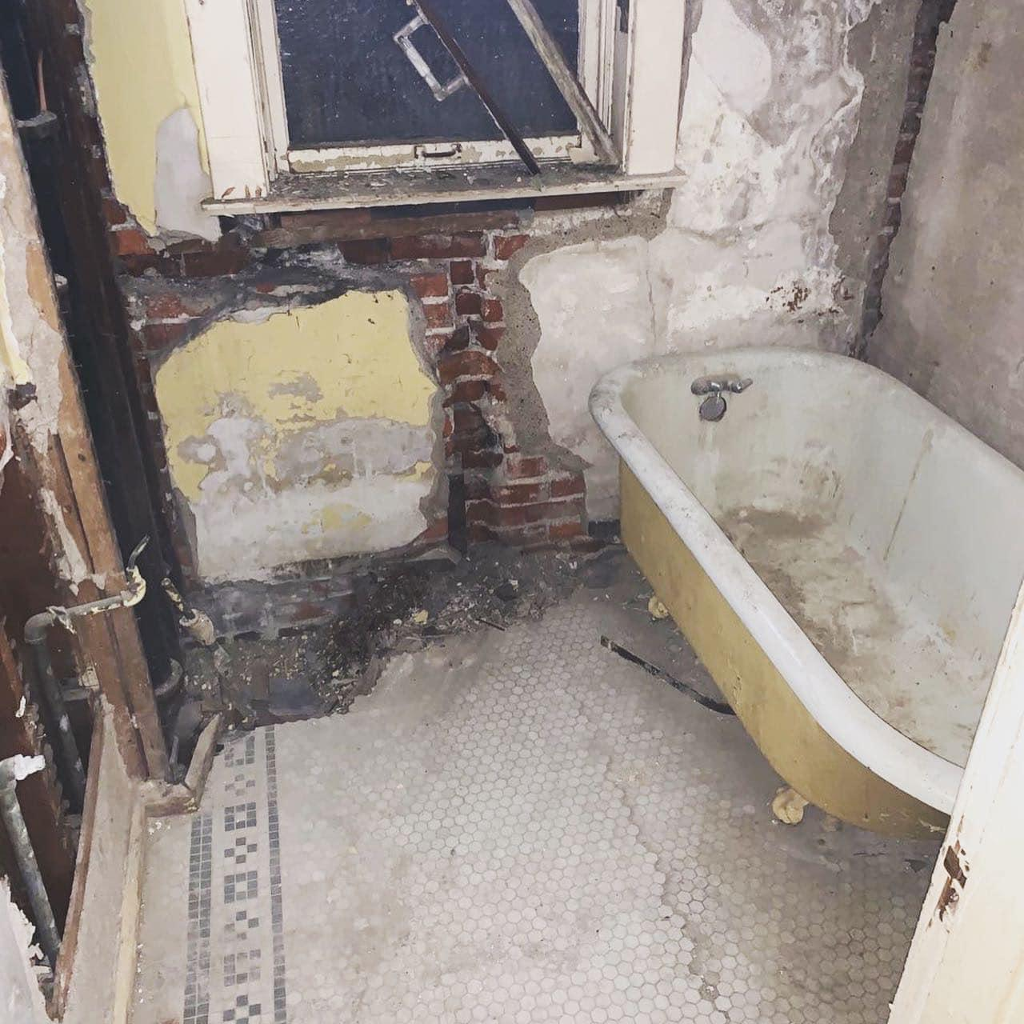
Cupples Place – Before

Slide 12
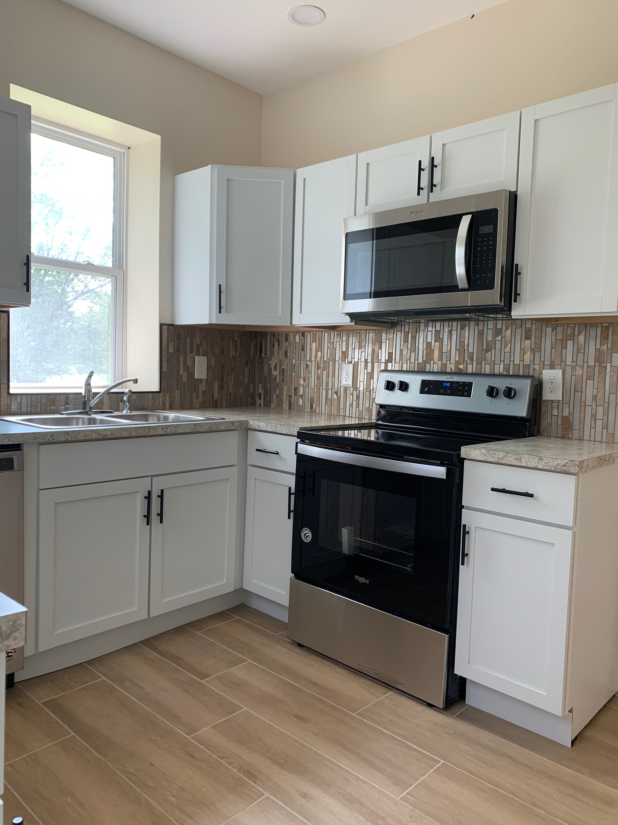
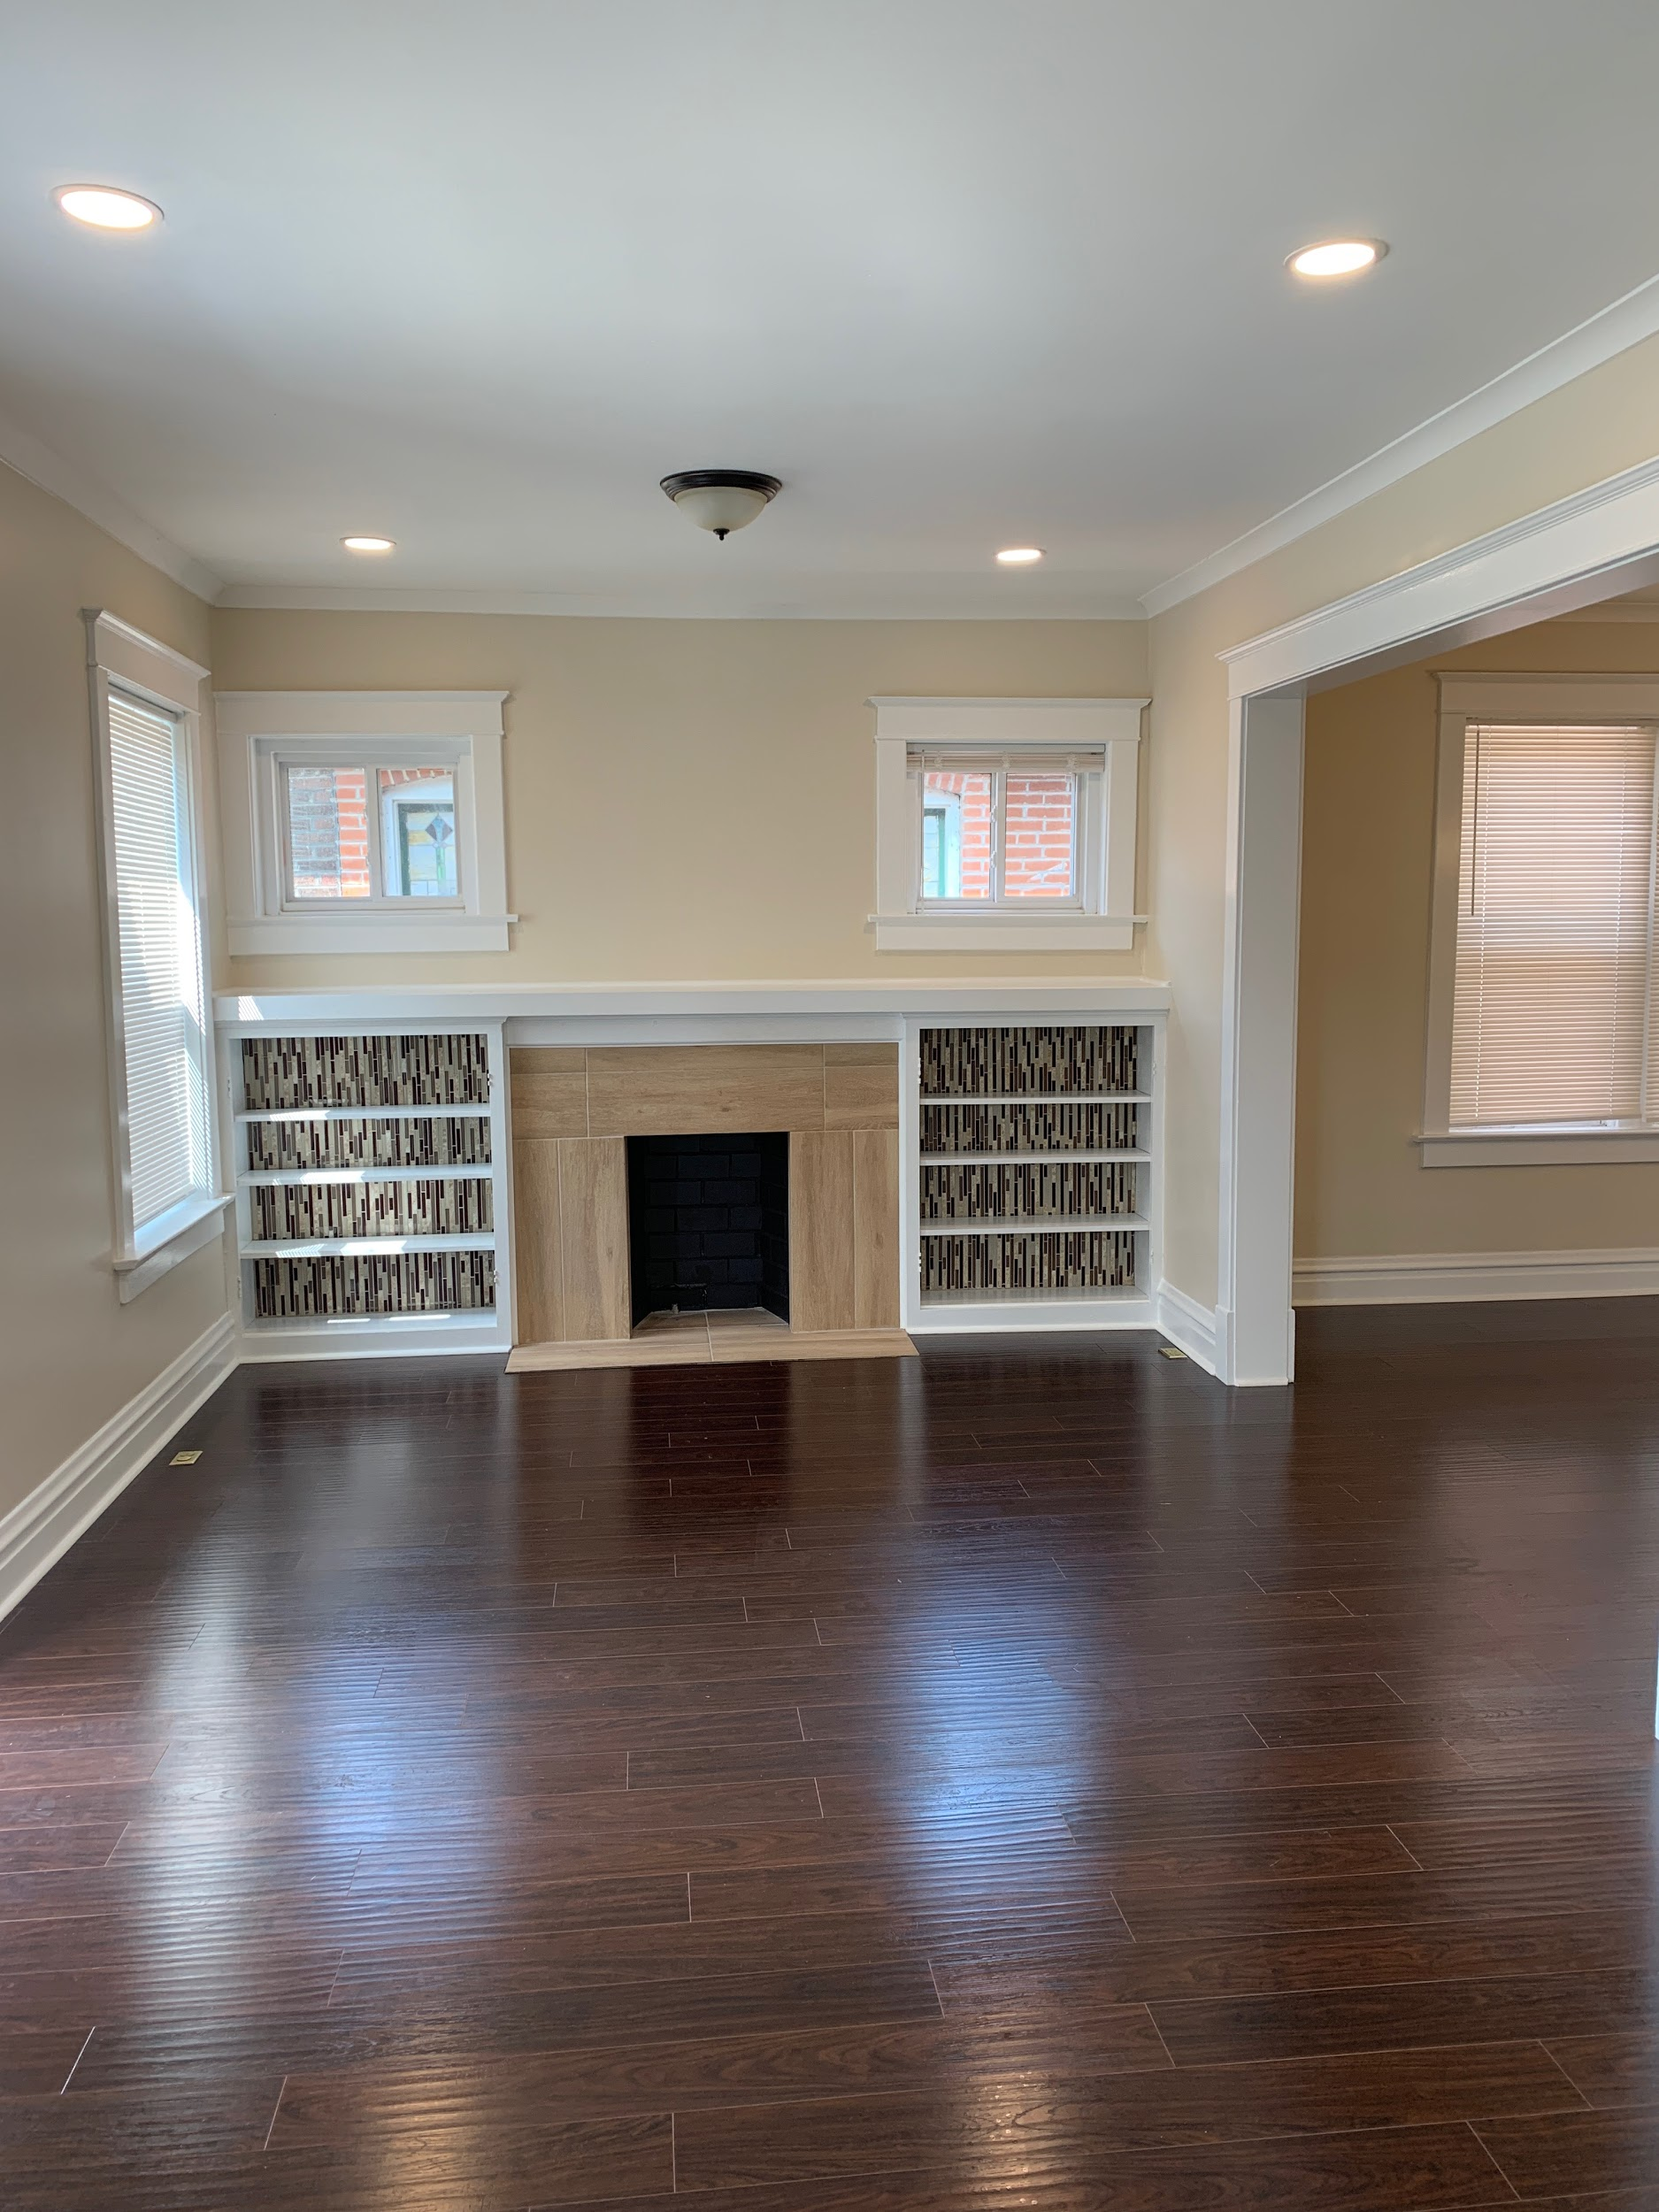
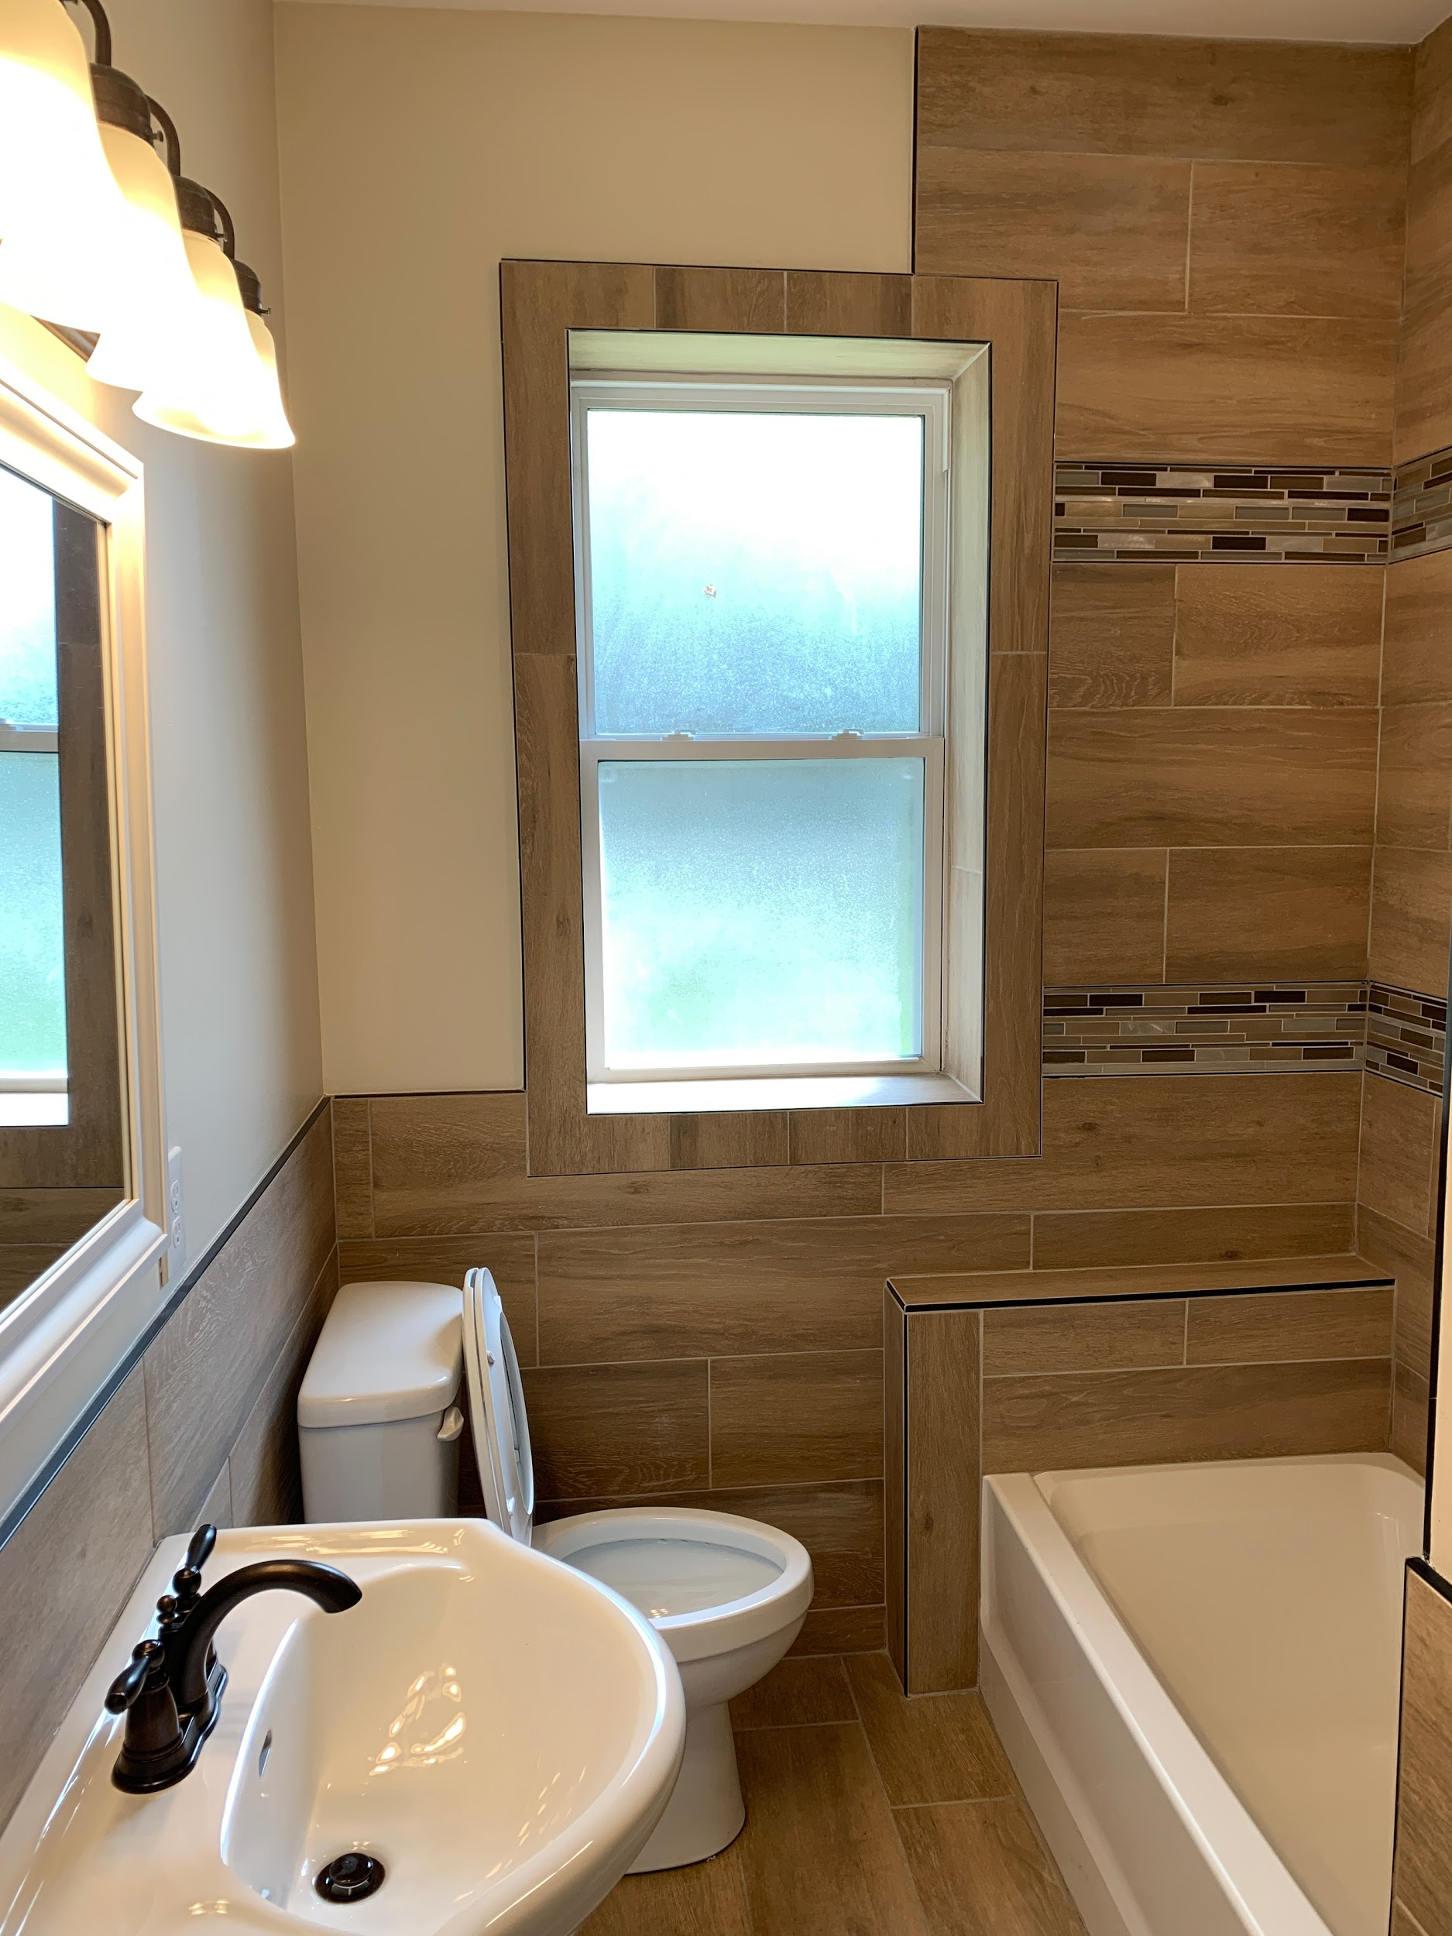
Cupples Place – After

Slide 13
Completed Social Impact Partnership Projects

Slide 14
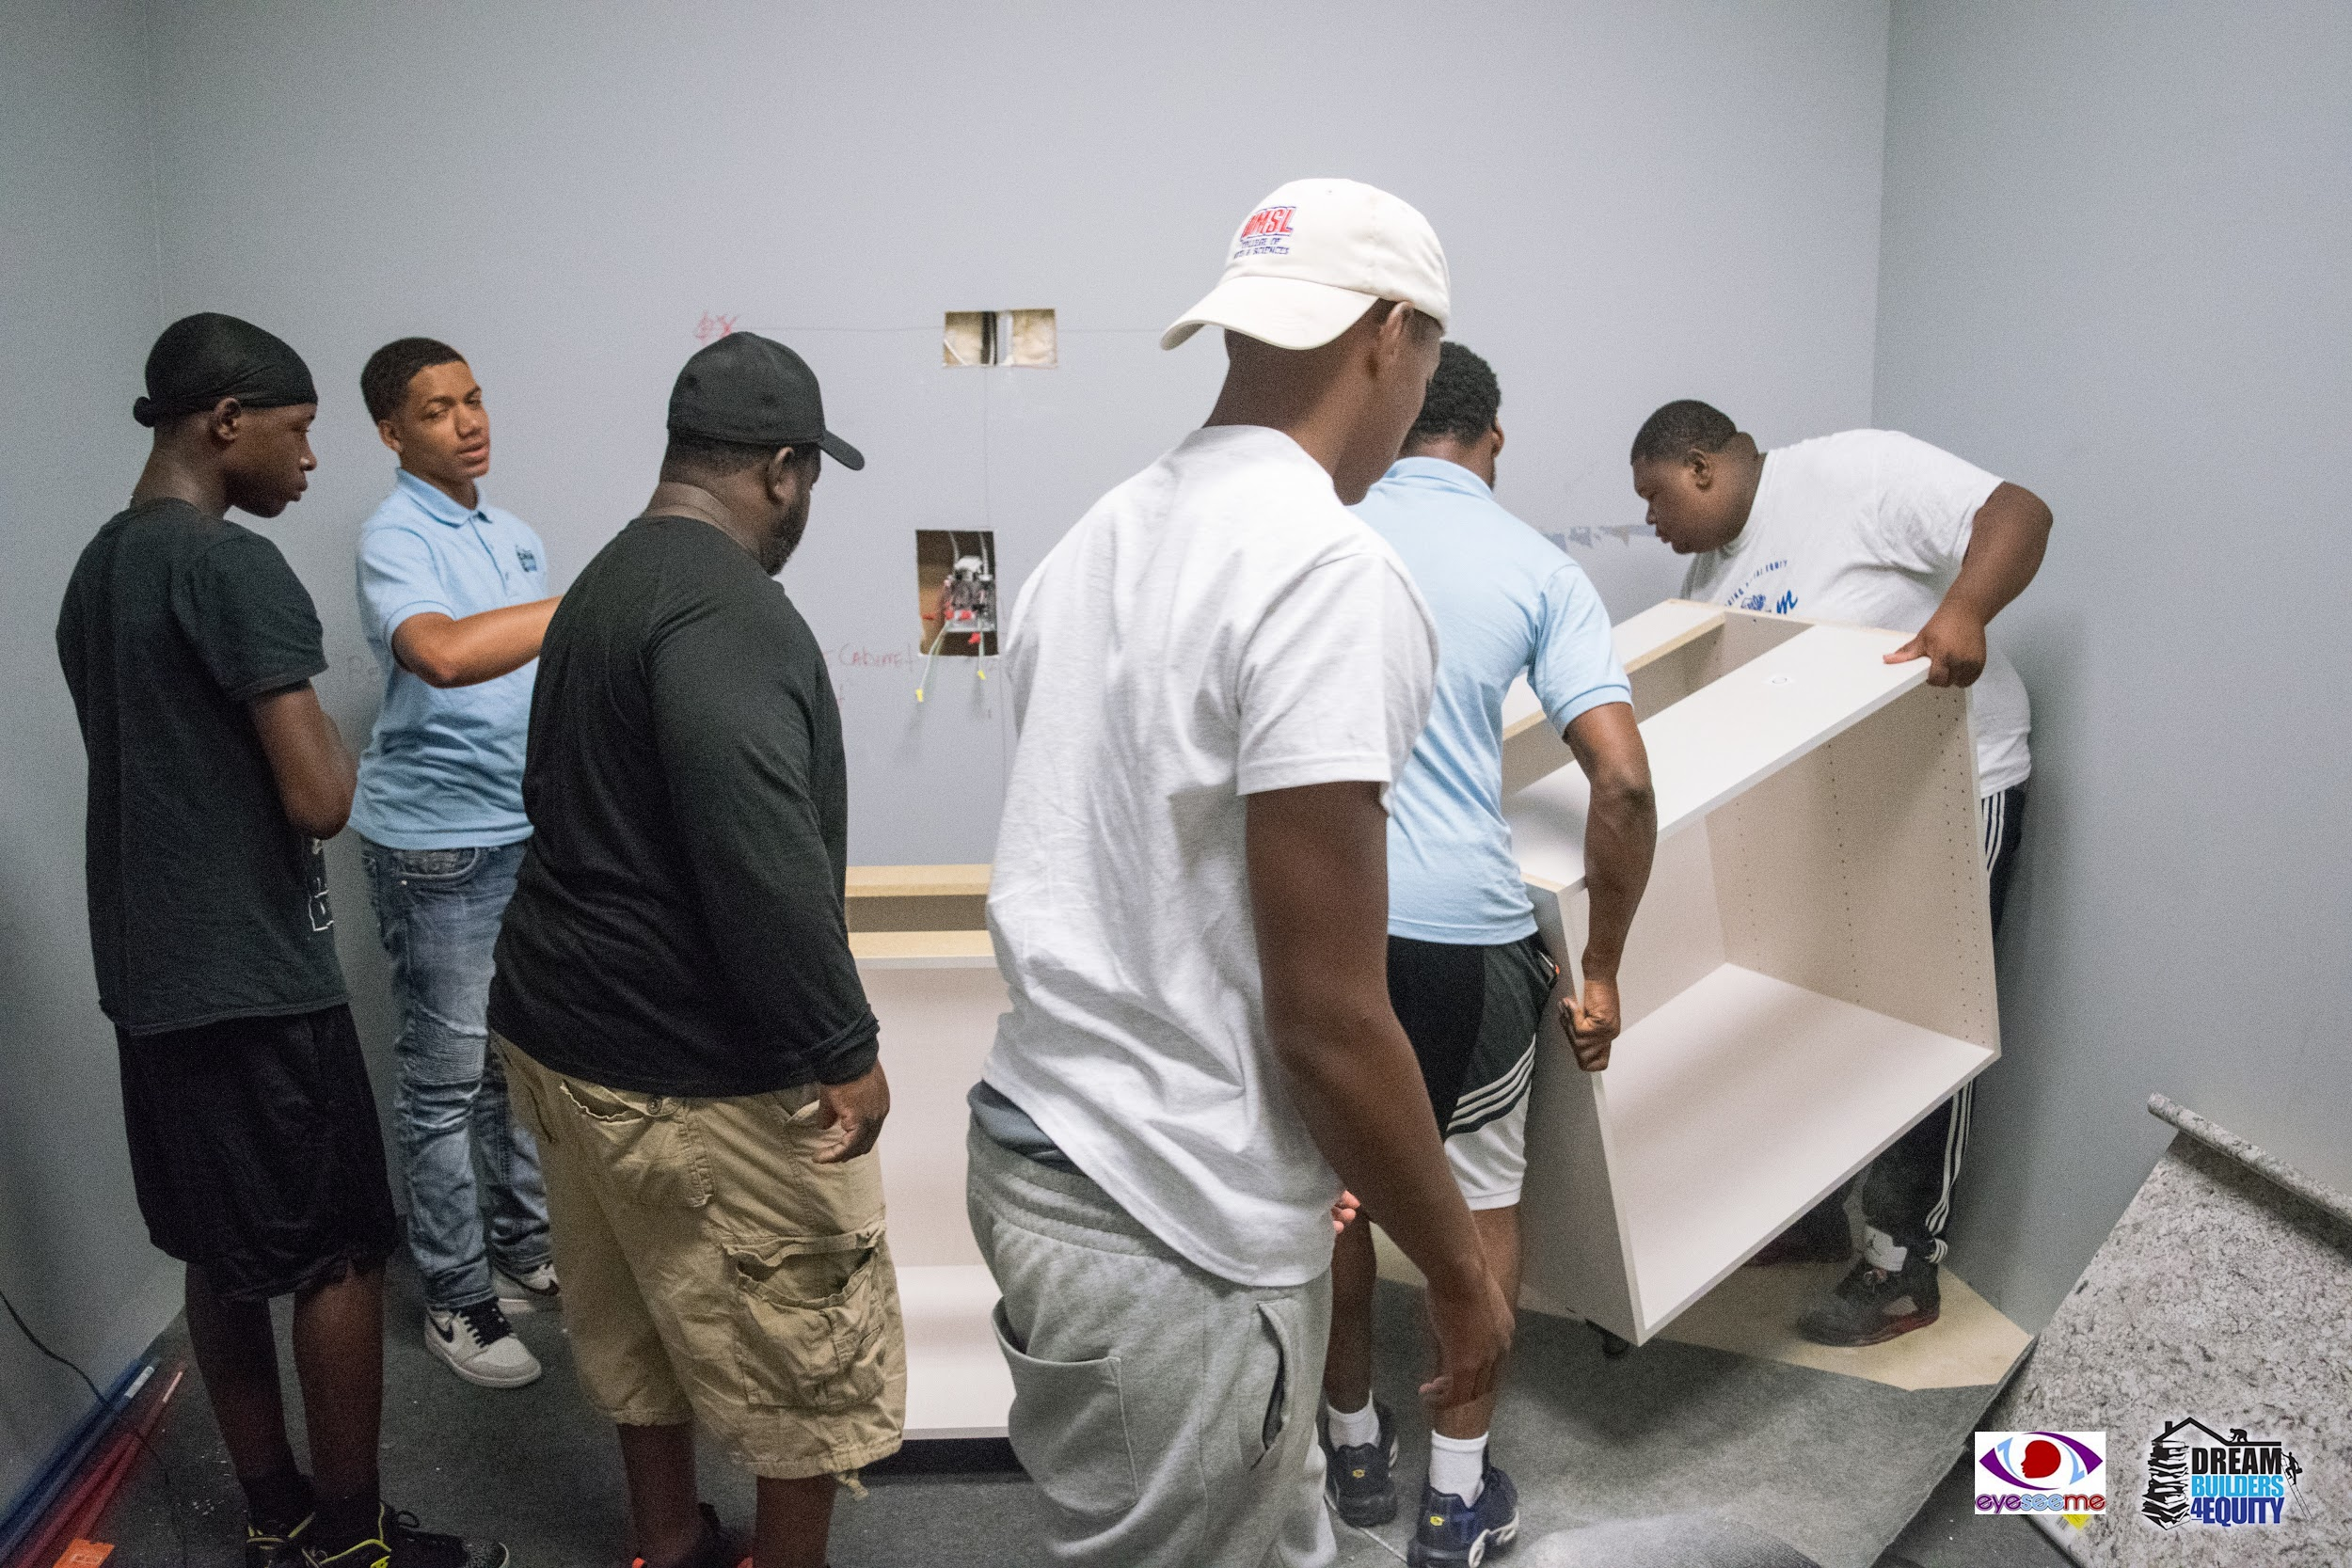
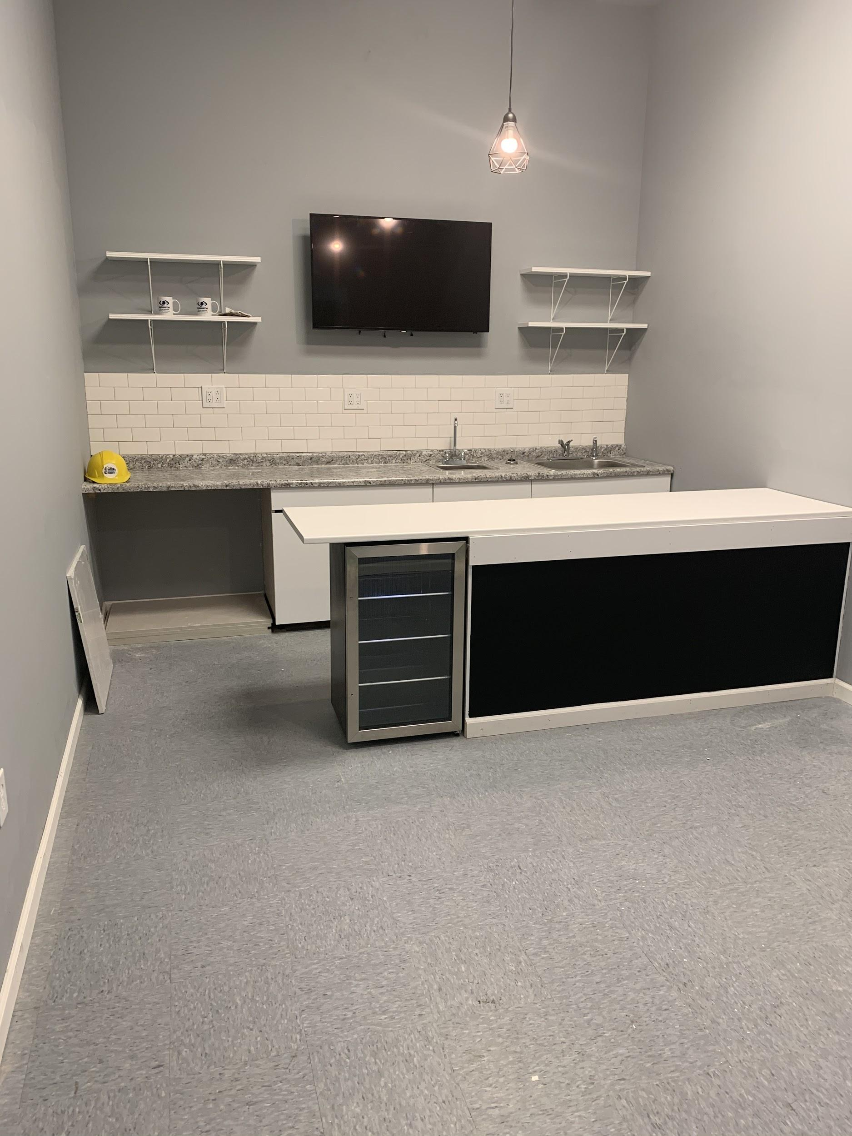
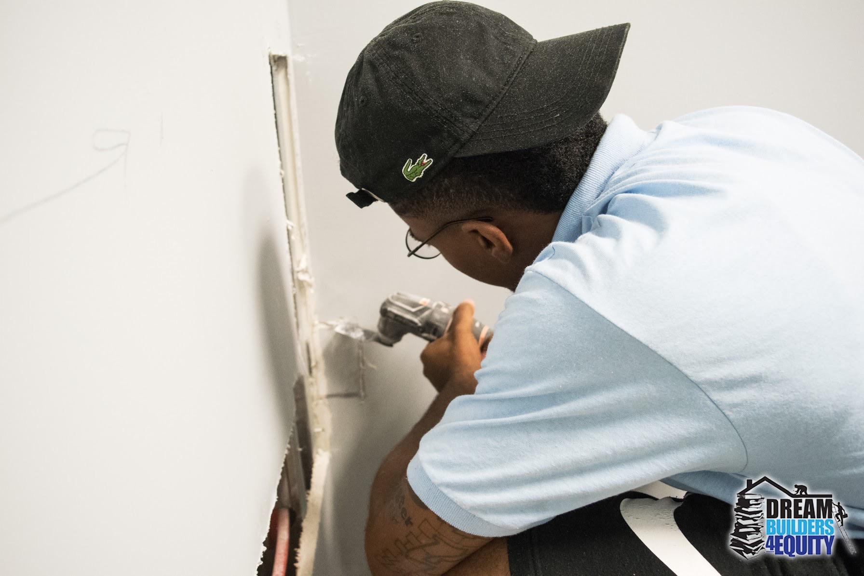
EyeSeeMe Children’s Bookstore
Notes:
In 2019, DB4E was hired to add a cafe in Eyeseeme Children's Bookstore

Slide 15
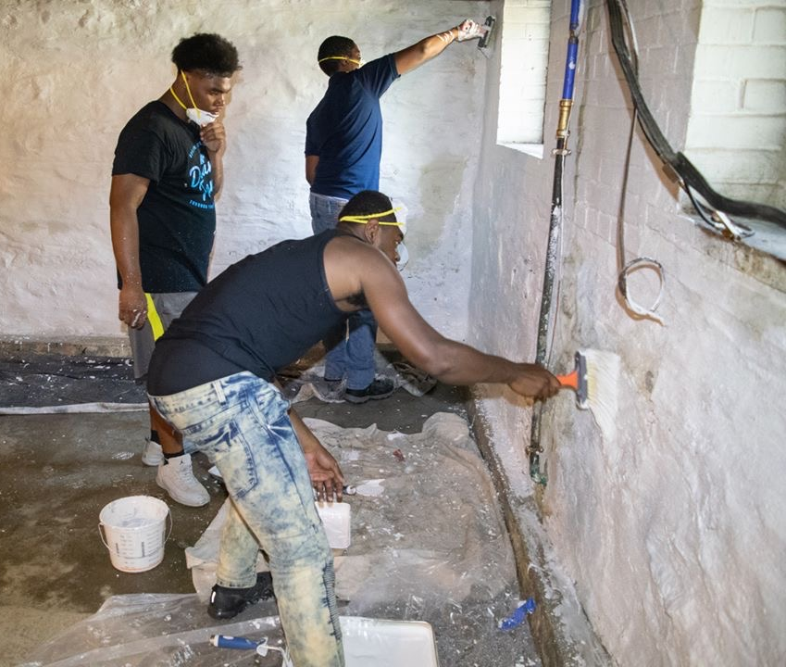
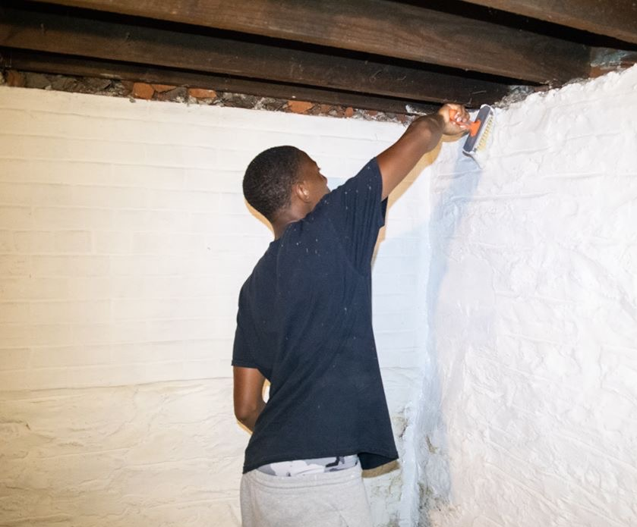
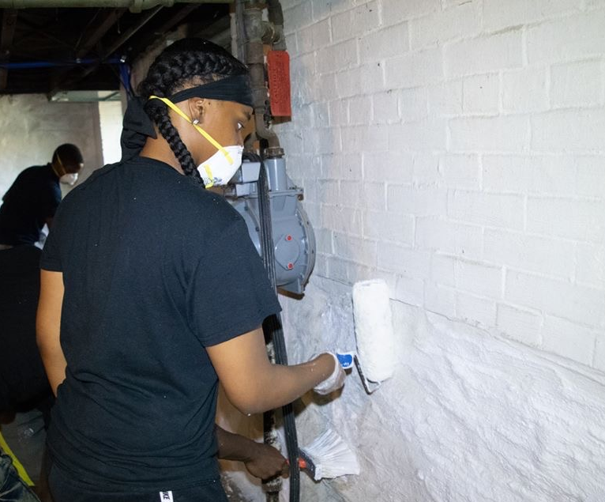
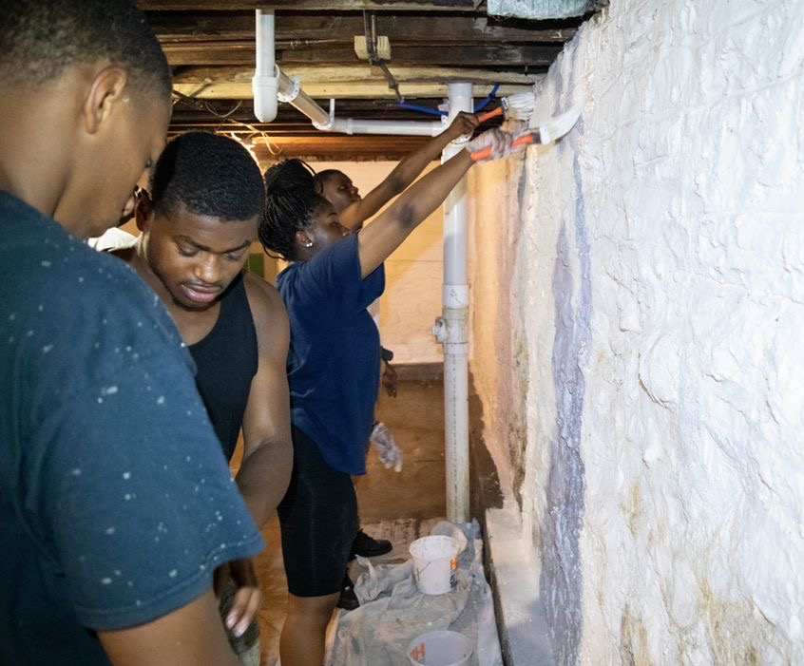
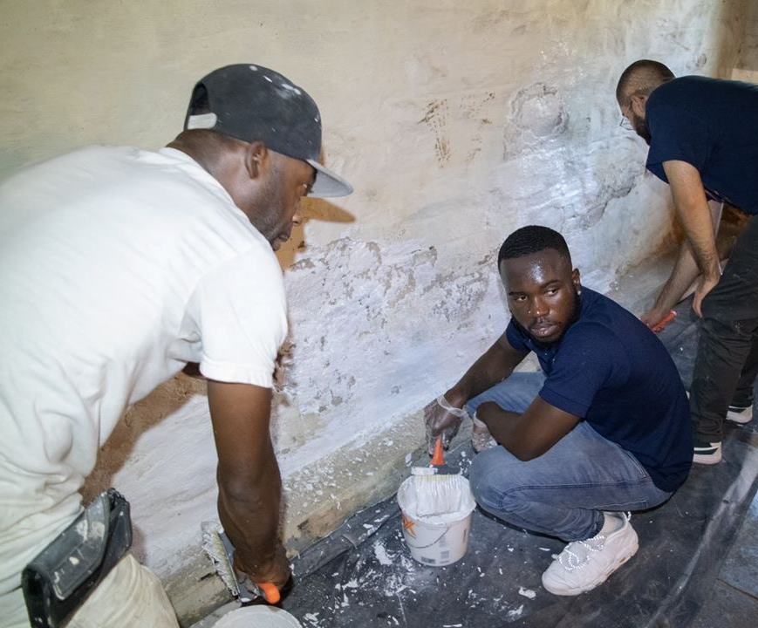
St. Joseph Housing Initiative
Notes:
In 2019, DB4E was hired to Drylok the basement of a St. Joseph Housing Initiative home in South St. Louis City.

Slide 16
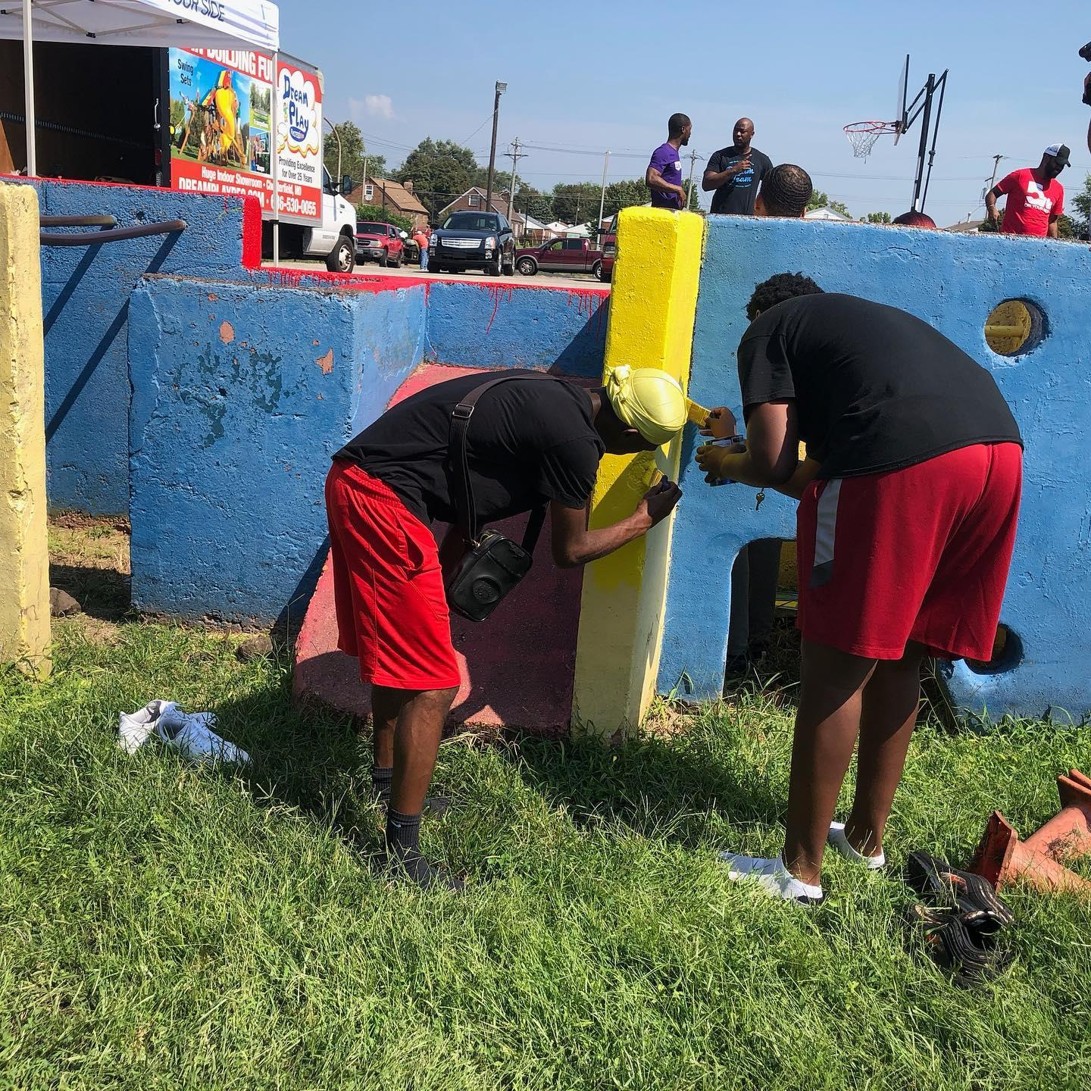
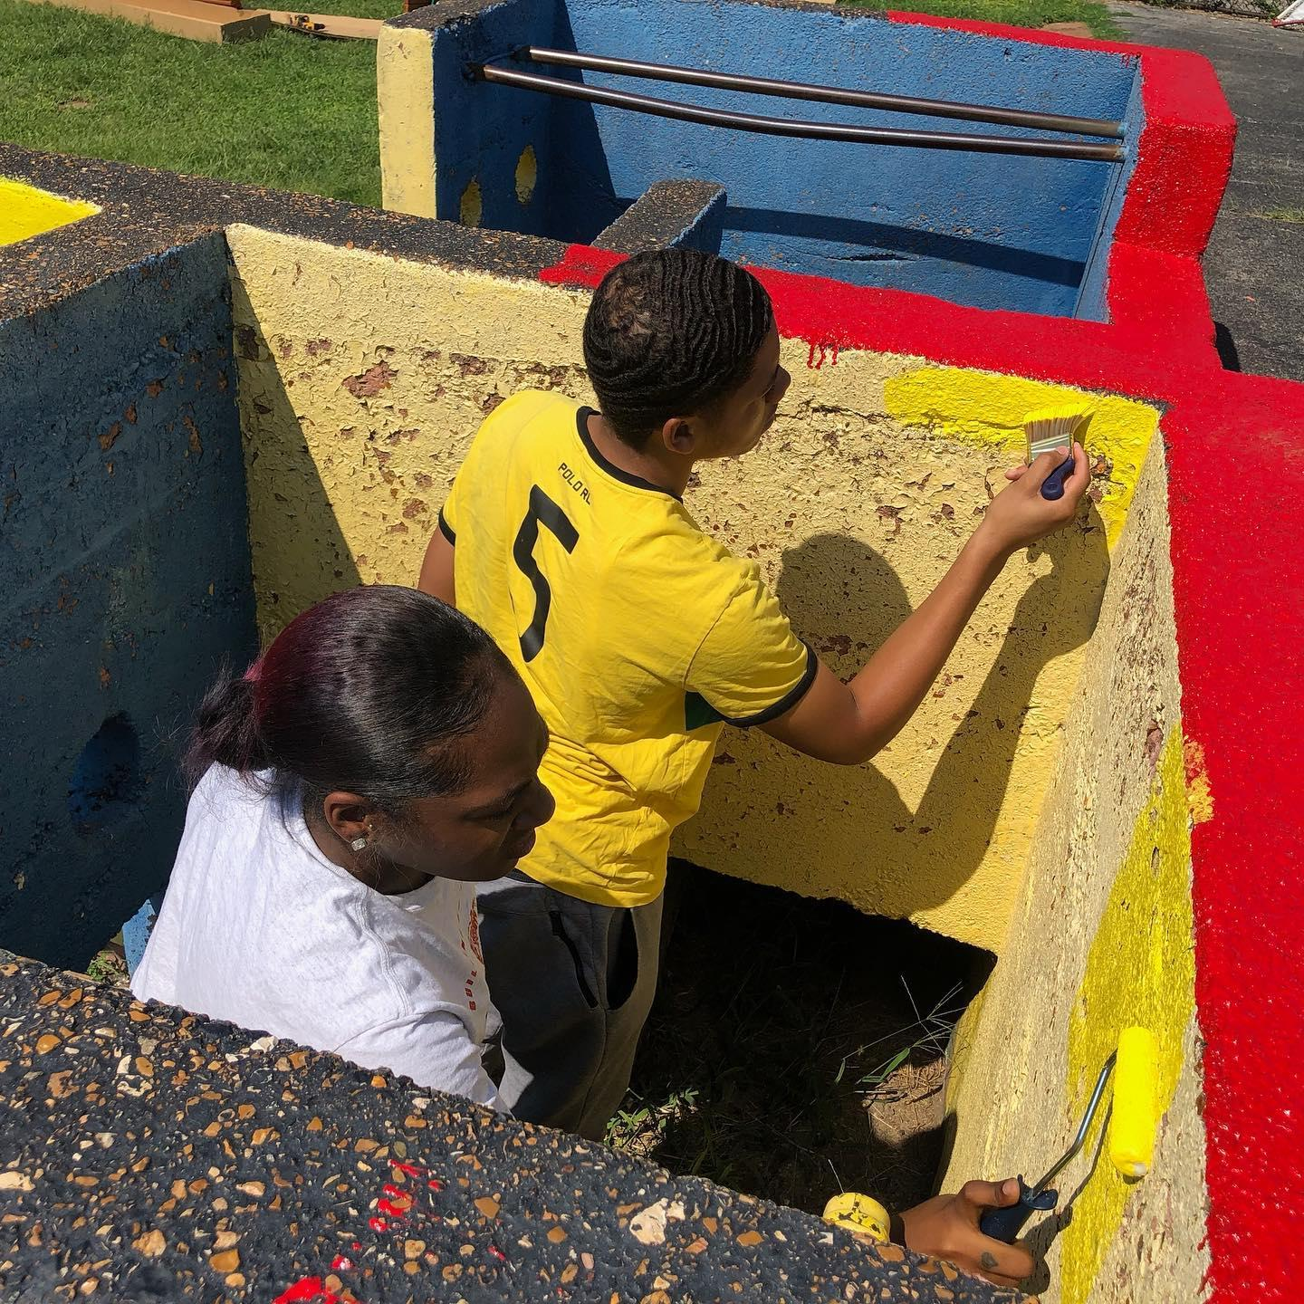
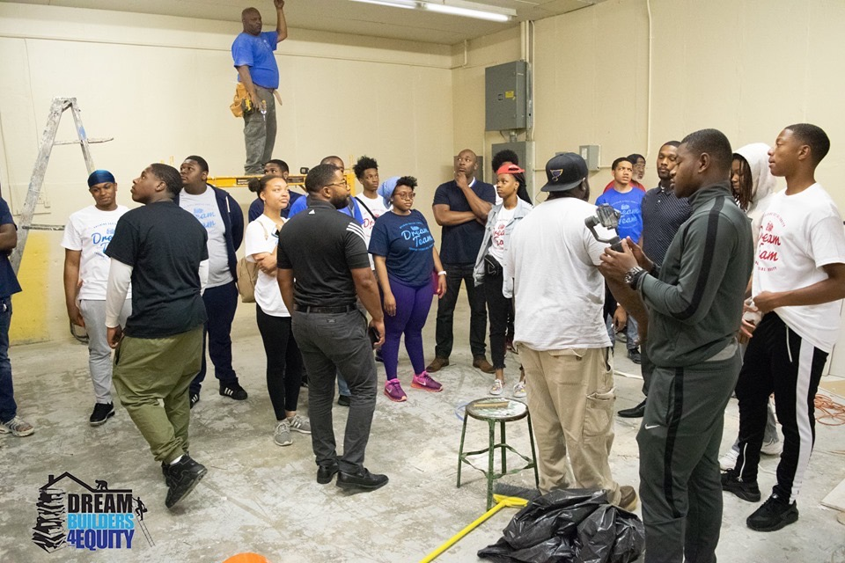
Wesley House Association
Notes:
In 2019, DB4E did a complete remodel of the non-profit Wesley House Association's facility.

Slide 17
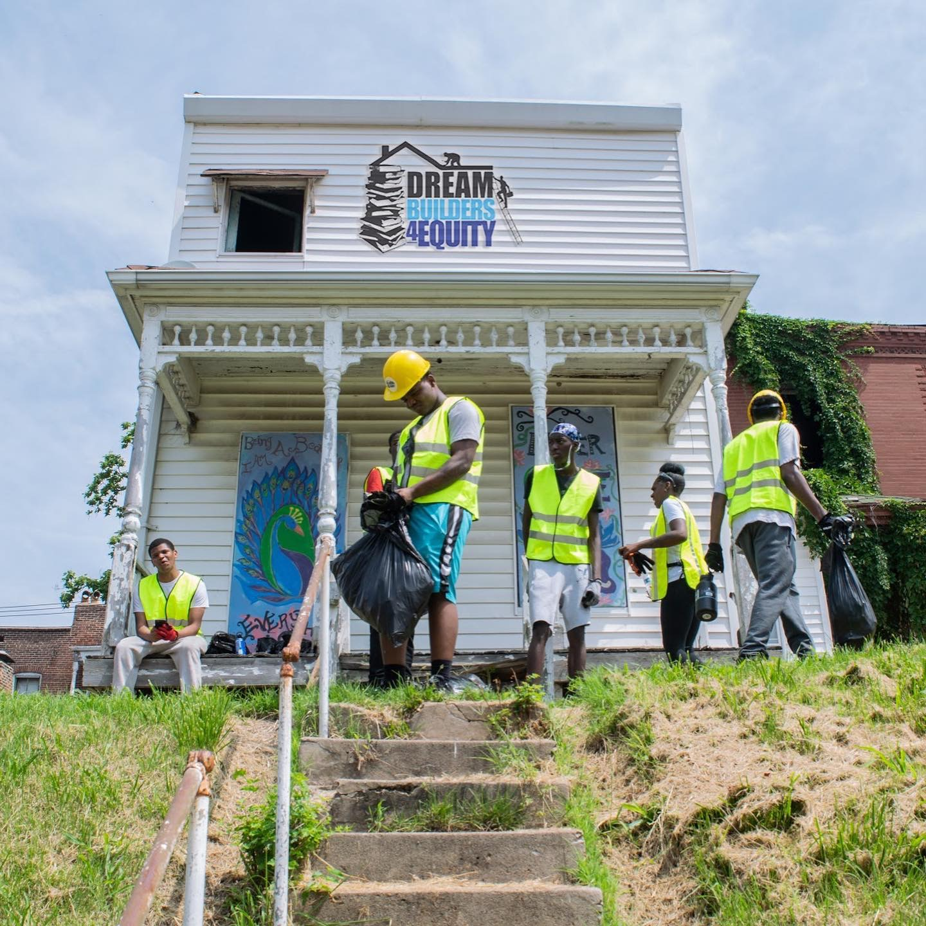
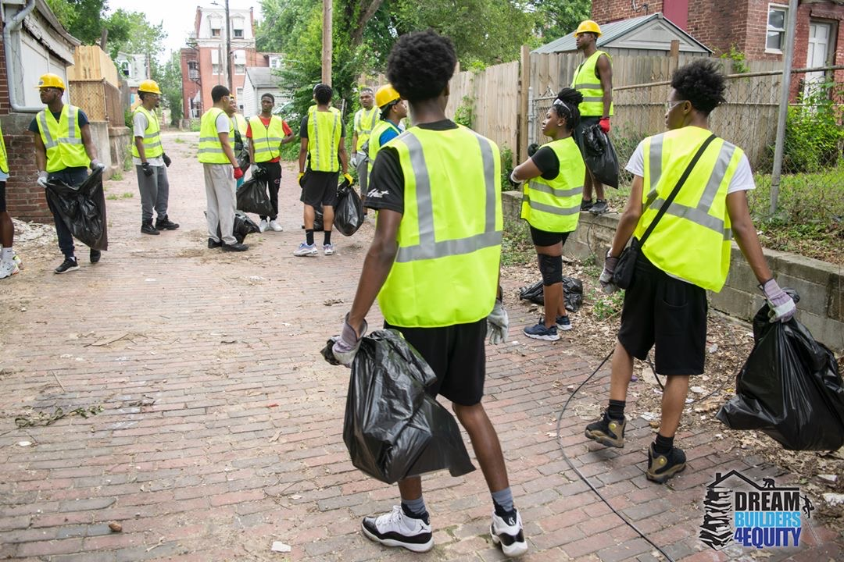
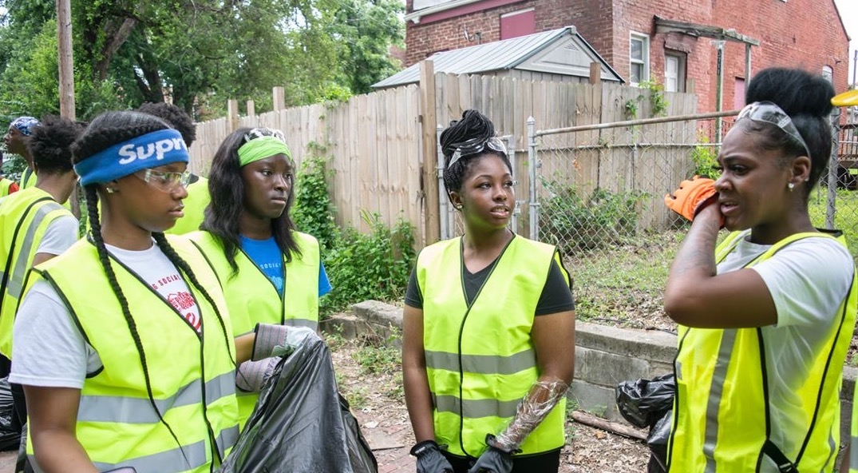
Art Place Initiative
Notes:
In 2019, DB4E was hired by the Art Place Initiative to lead the maintenance and stabilization of the 25 Parcel Development

Slide 18
Our Milestones
Founded in 2016
Initial cohort in 2017

Slide 19
Youth Wealth Creation
Funds Created & Earned by Youth
60 Youth Served
60 Bank Accounts Opened
1,500+ Books Sold
5,200 Hours of Job-Readiness Training
4,100 Hours of Community Service
Youth are projected to receive $15K in scholarships from the sale of rehabbed Cupples Place property
$350K Youth Jobs
$32K Book Sales
$50K Scholarships
Total $432K in Youth Wealth Creation

Slide 20
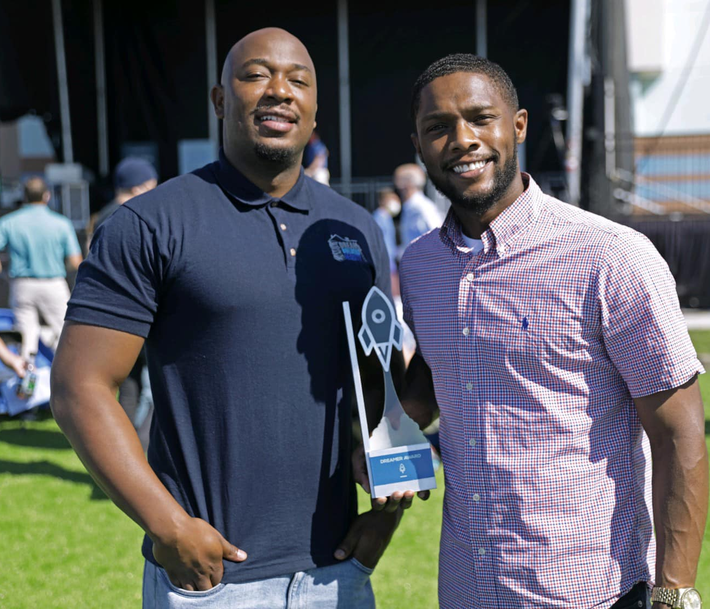
Awards
DB4E Documentary “ALL IN” was featured in the International Film Festival
Winners of Washington University Social Enterprise & Innovation Competition 2017
Winners of Launch Code’s Jim McKelvey Moonshot Dreamer Award in 2020

Slide 21
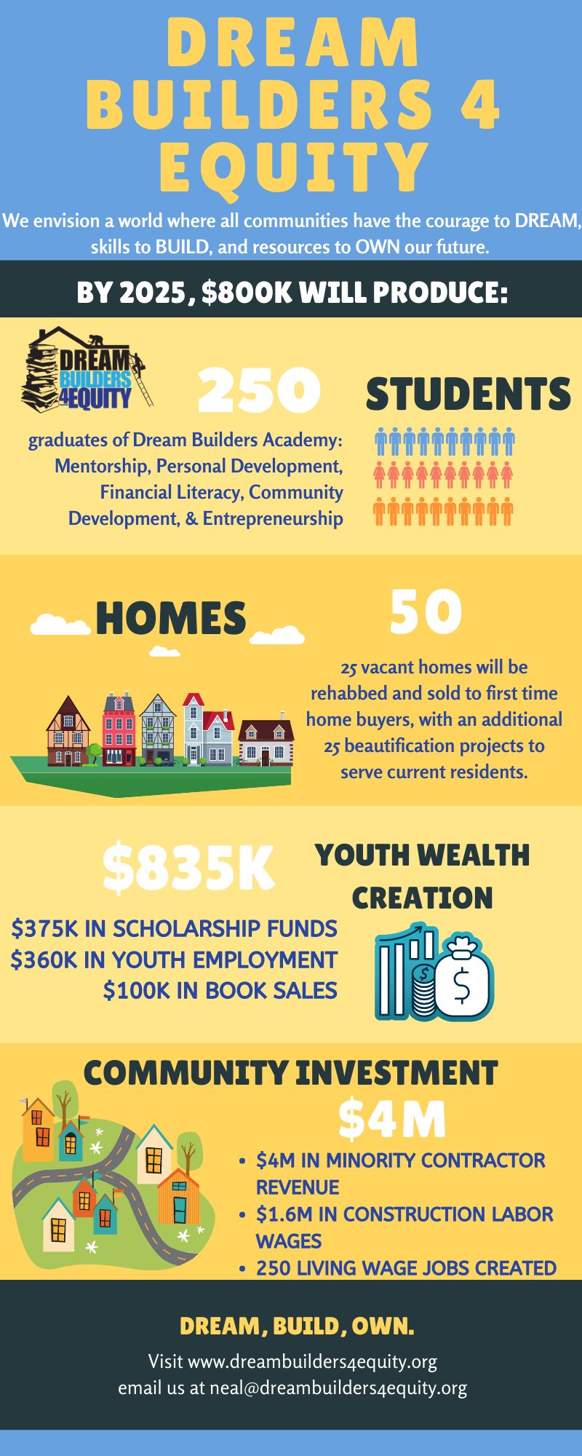
Hyde Park 2025 – Five Year Goals

Slide 22
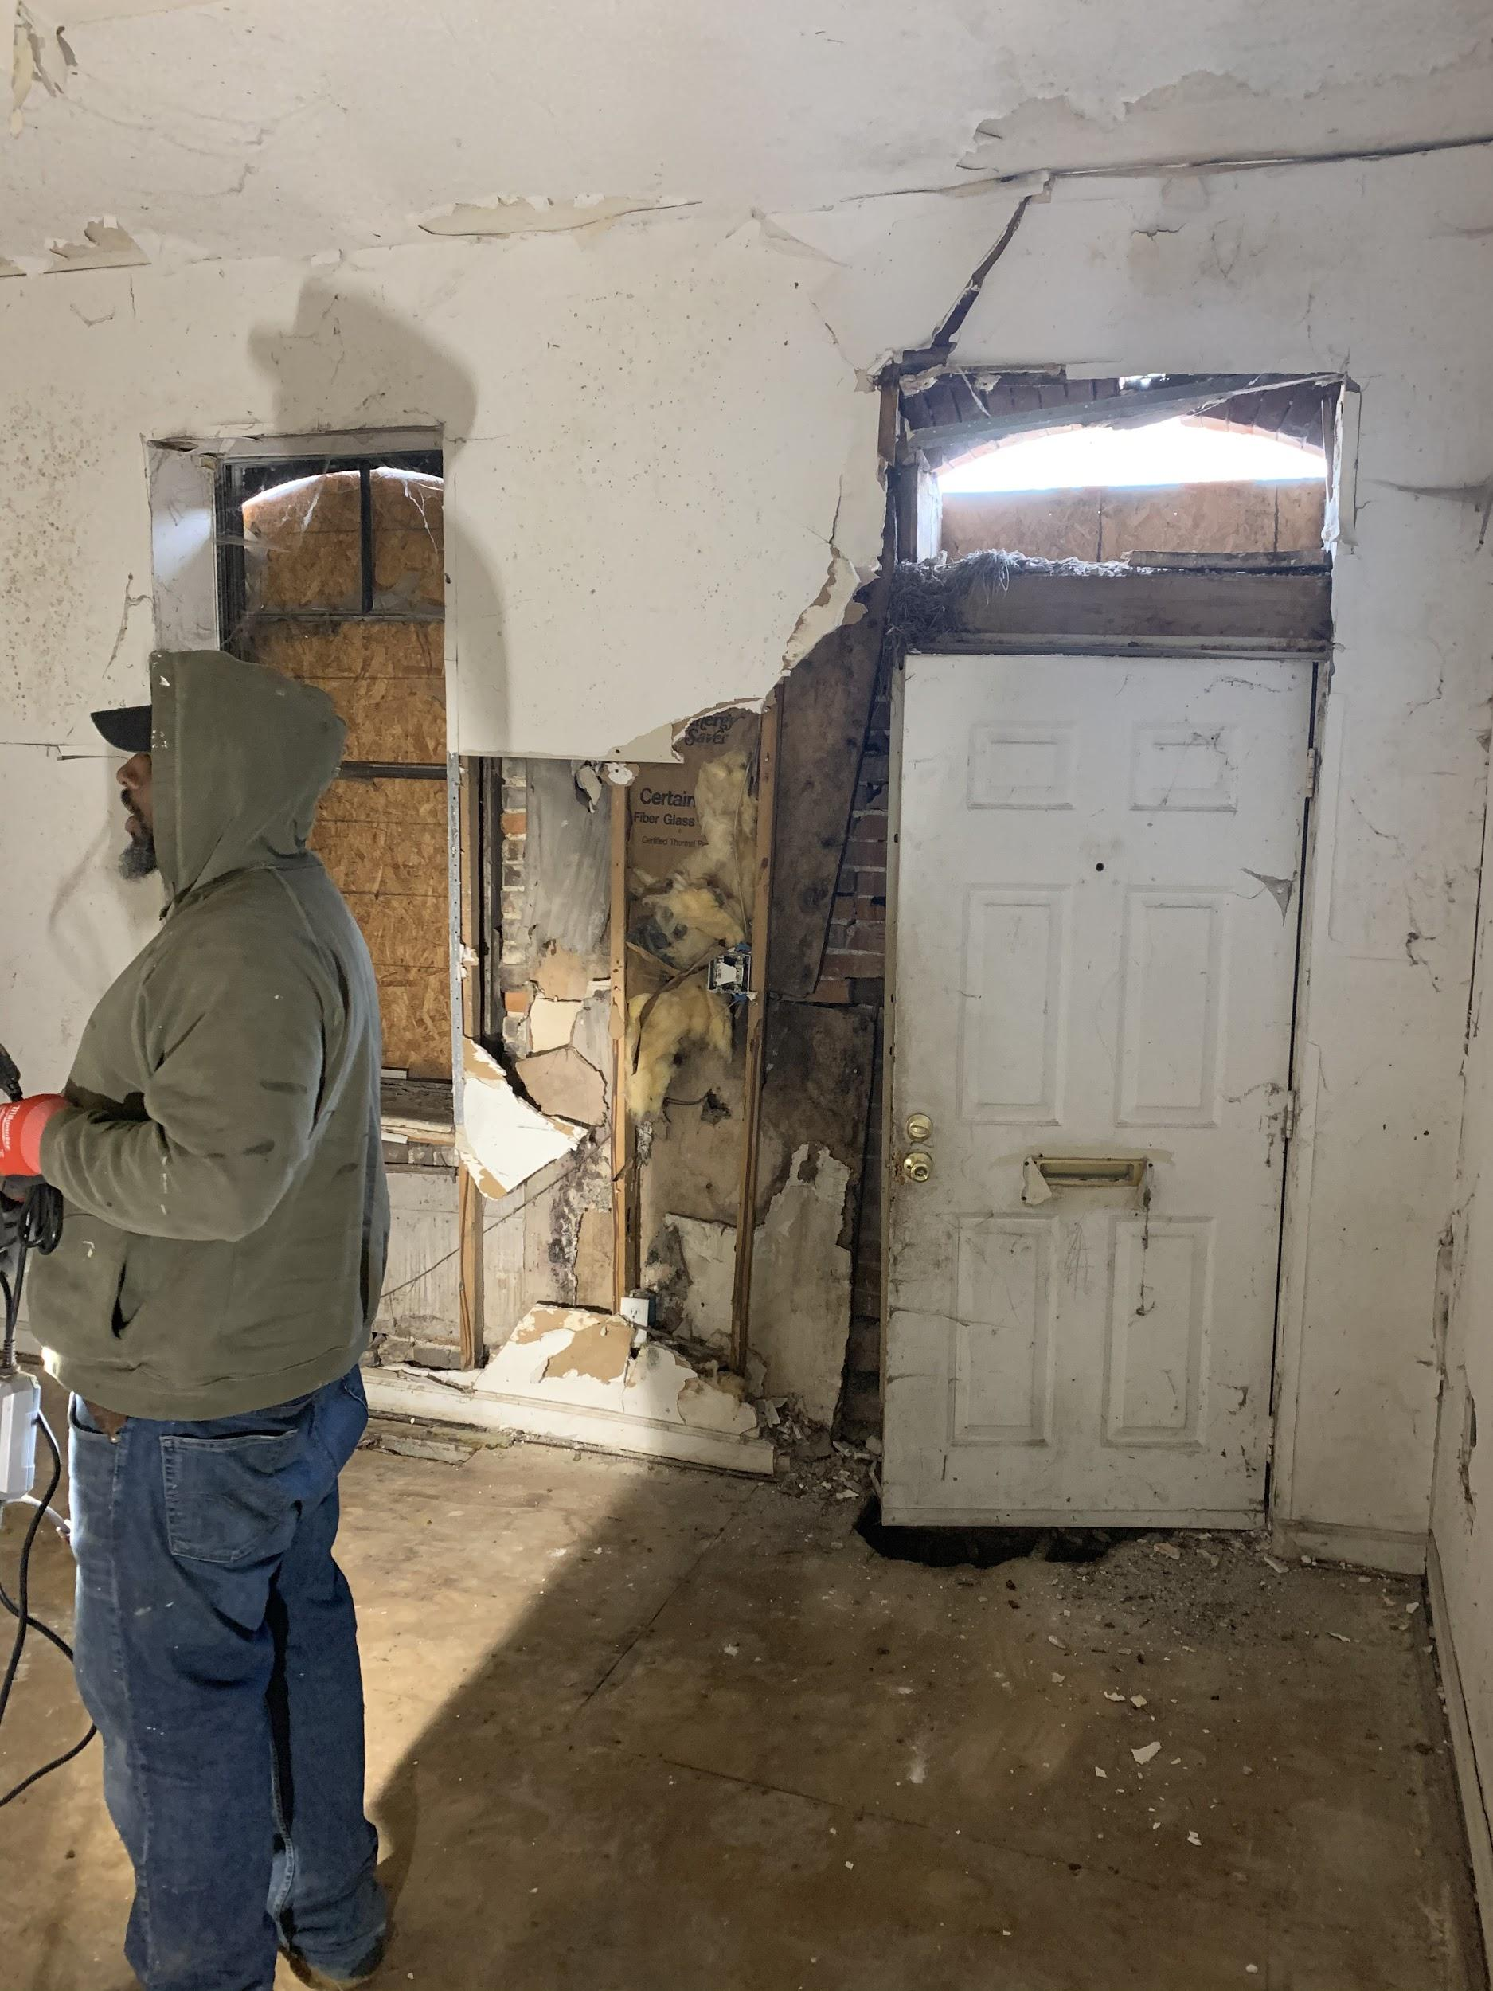
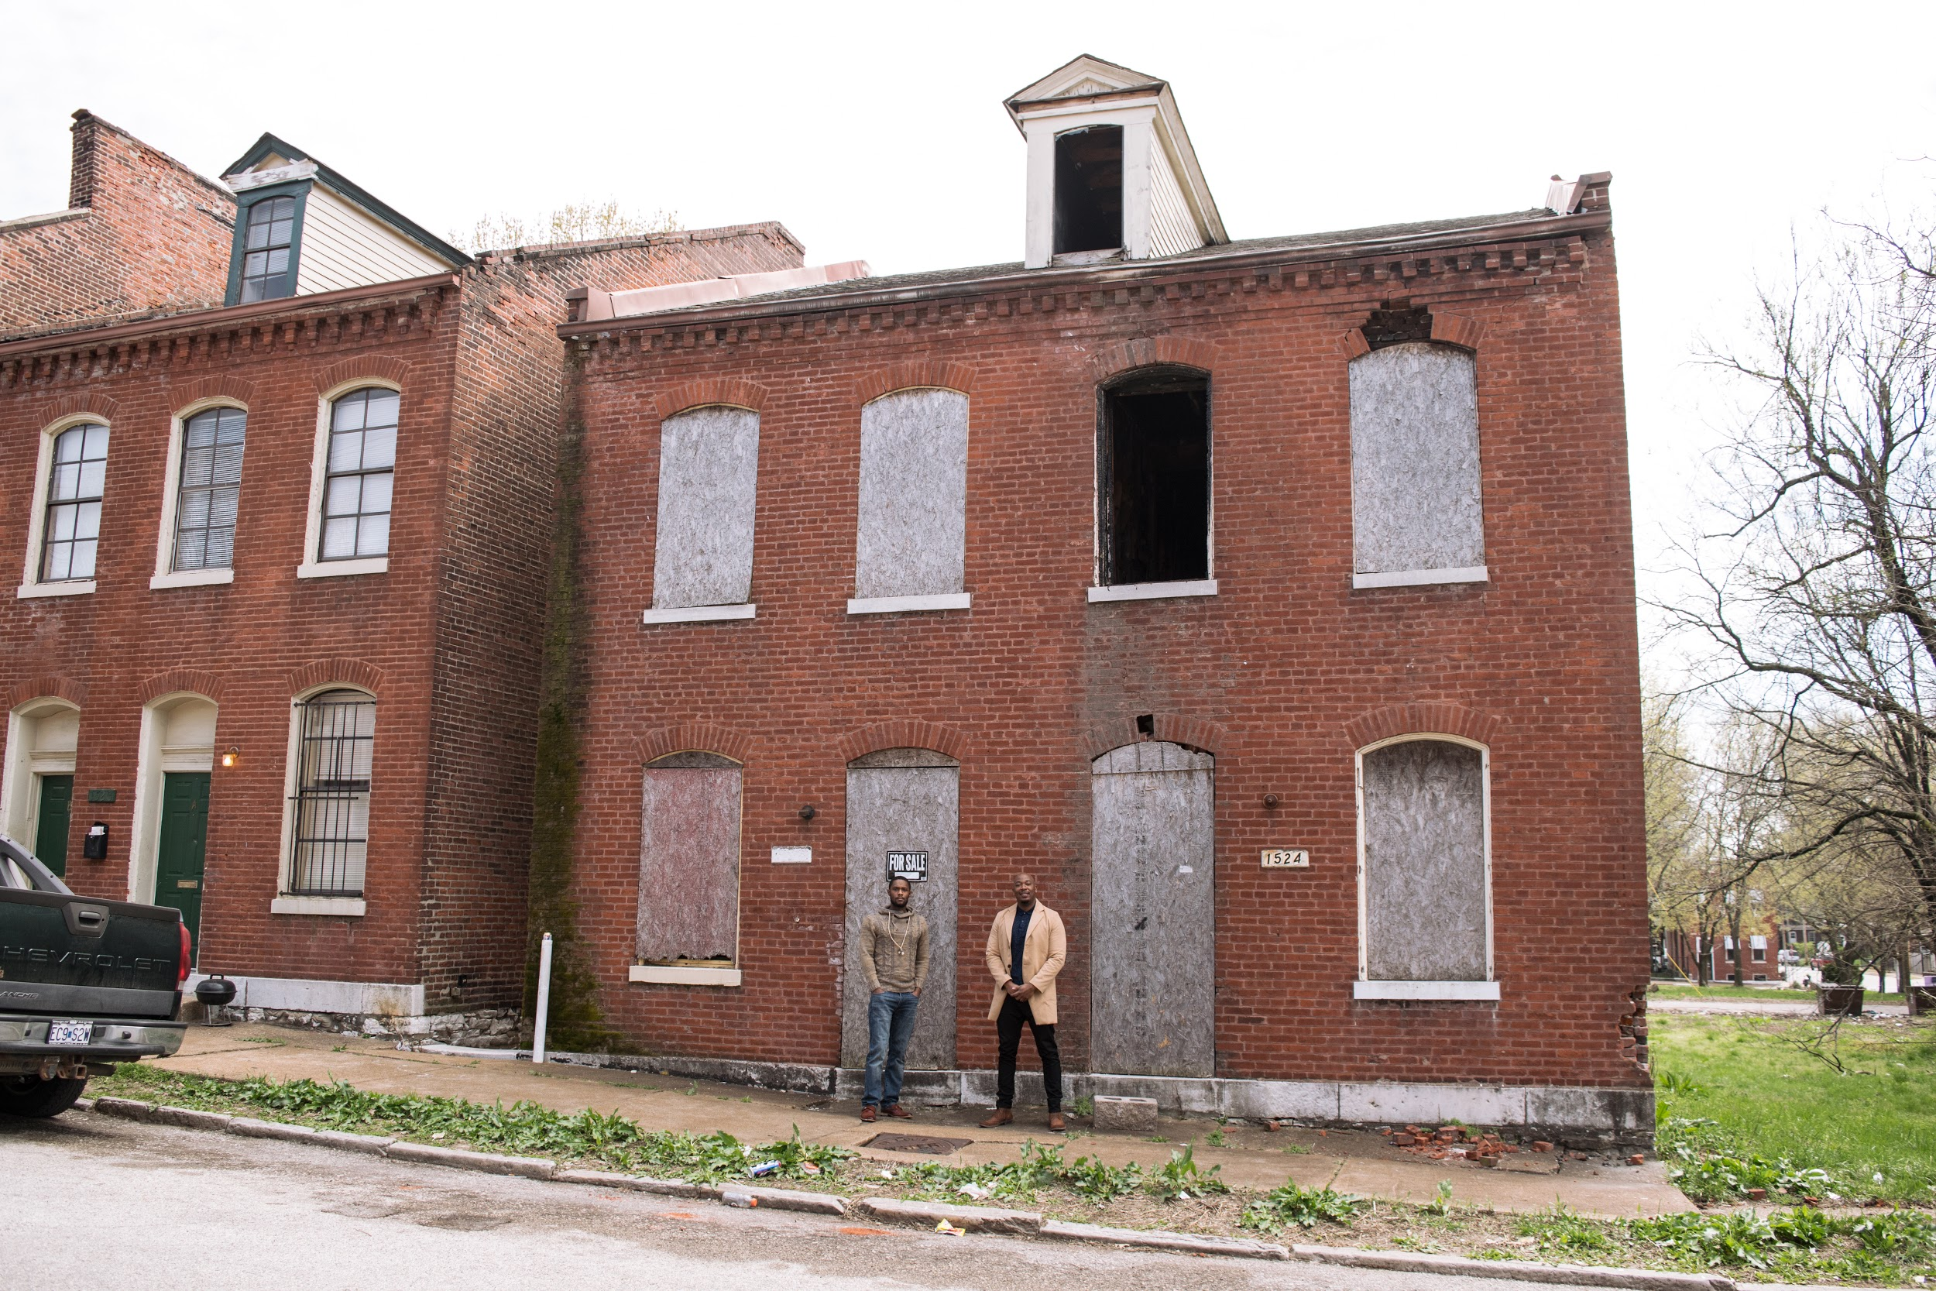
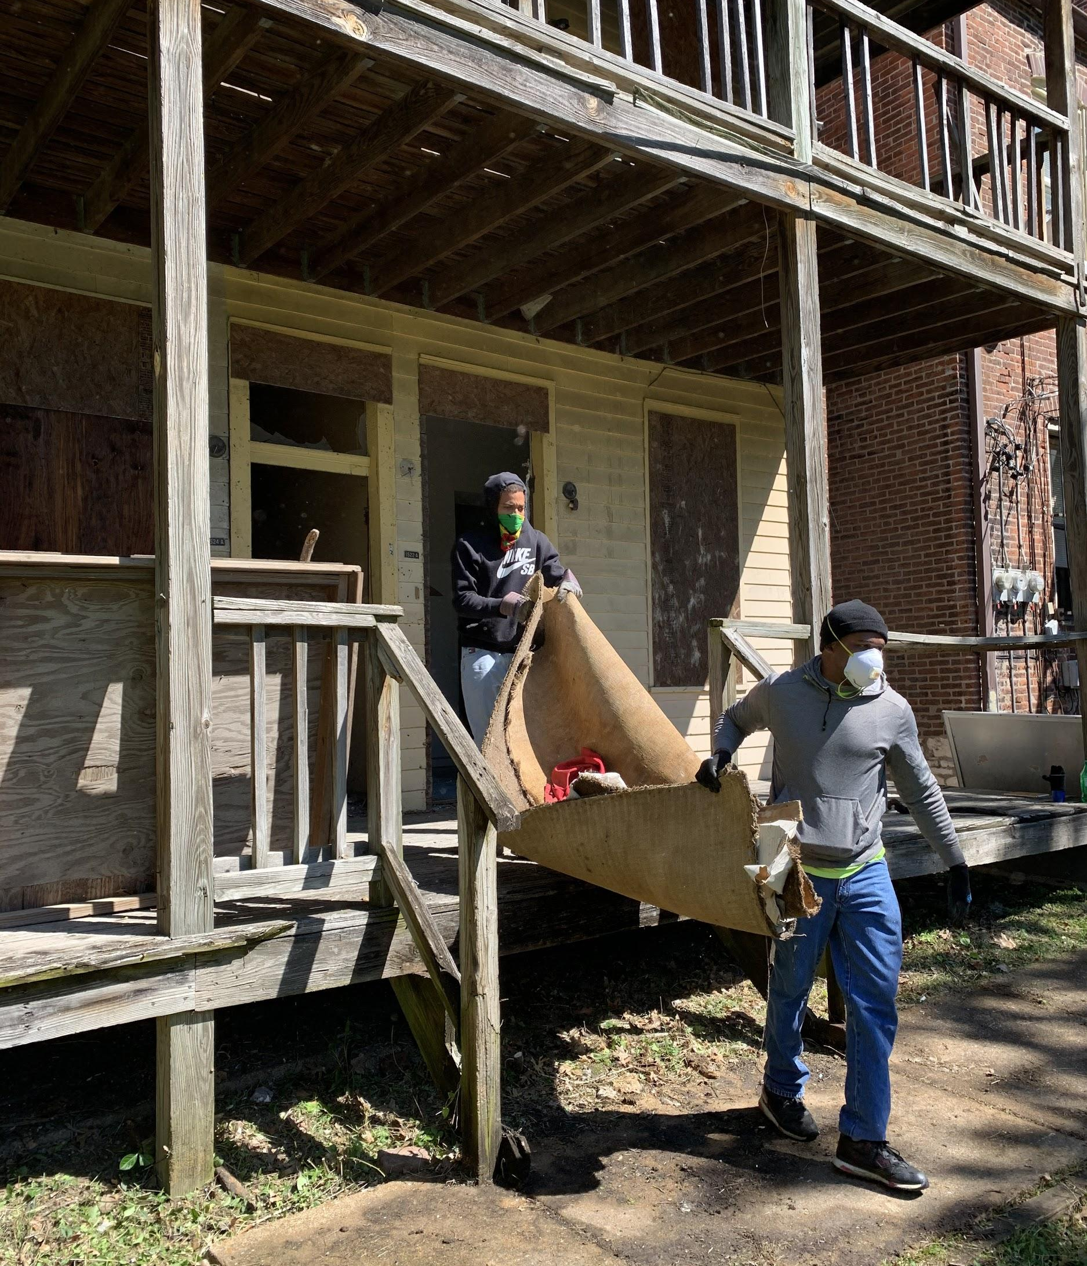
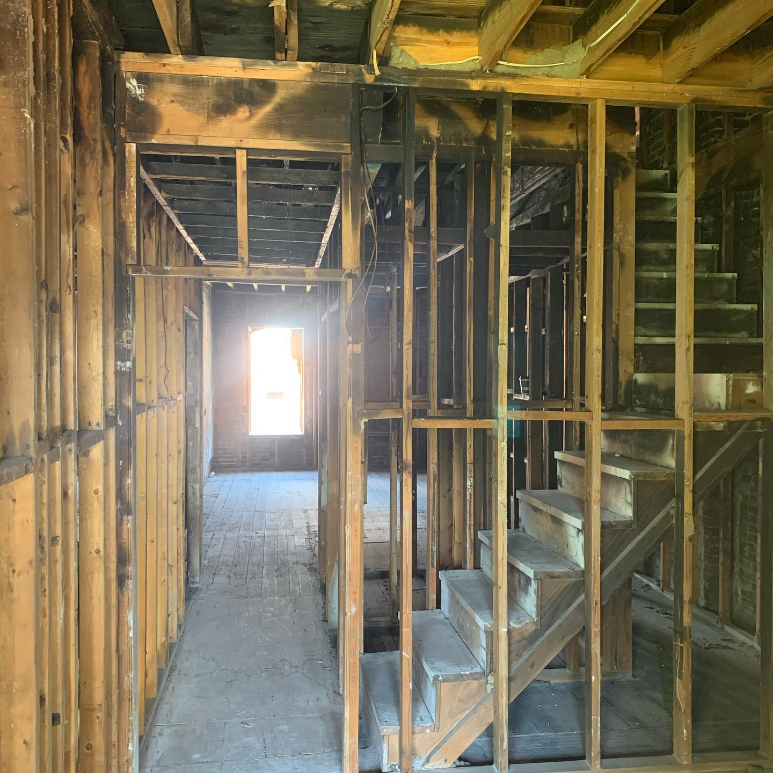
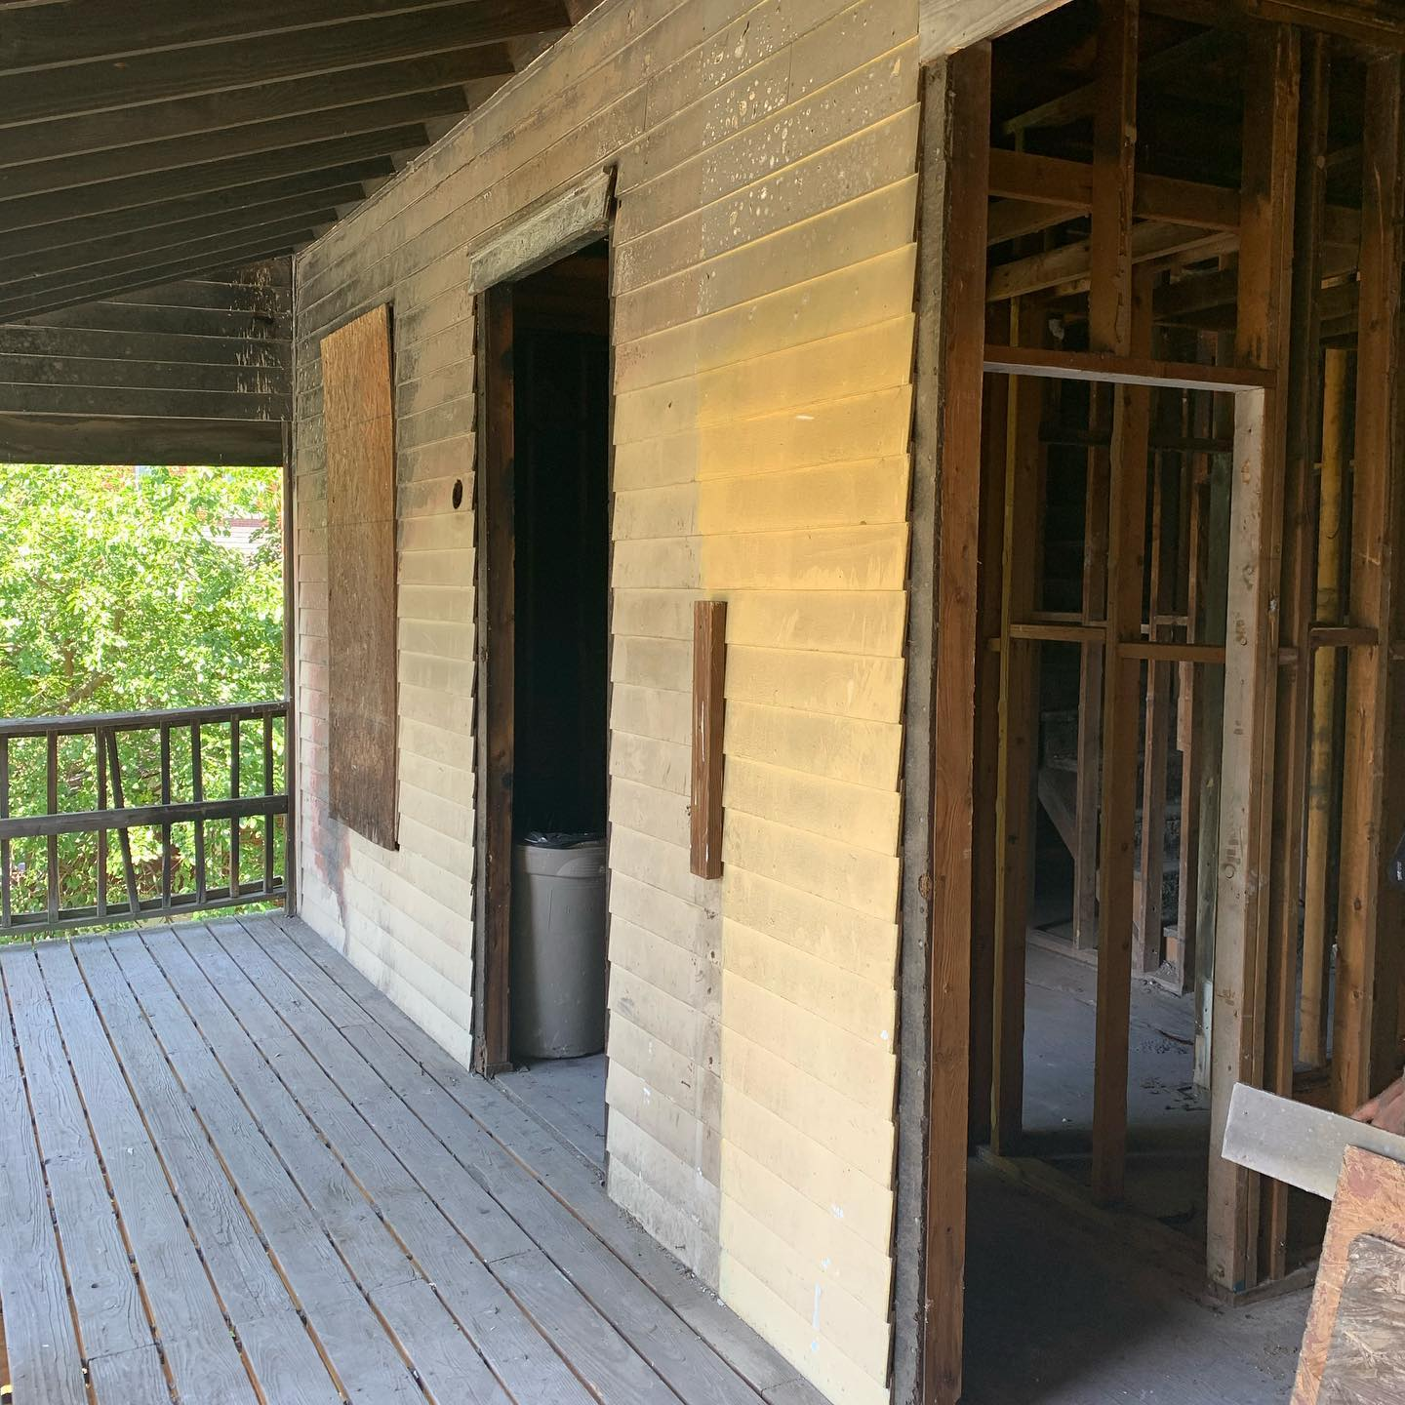
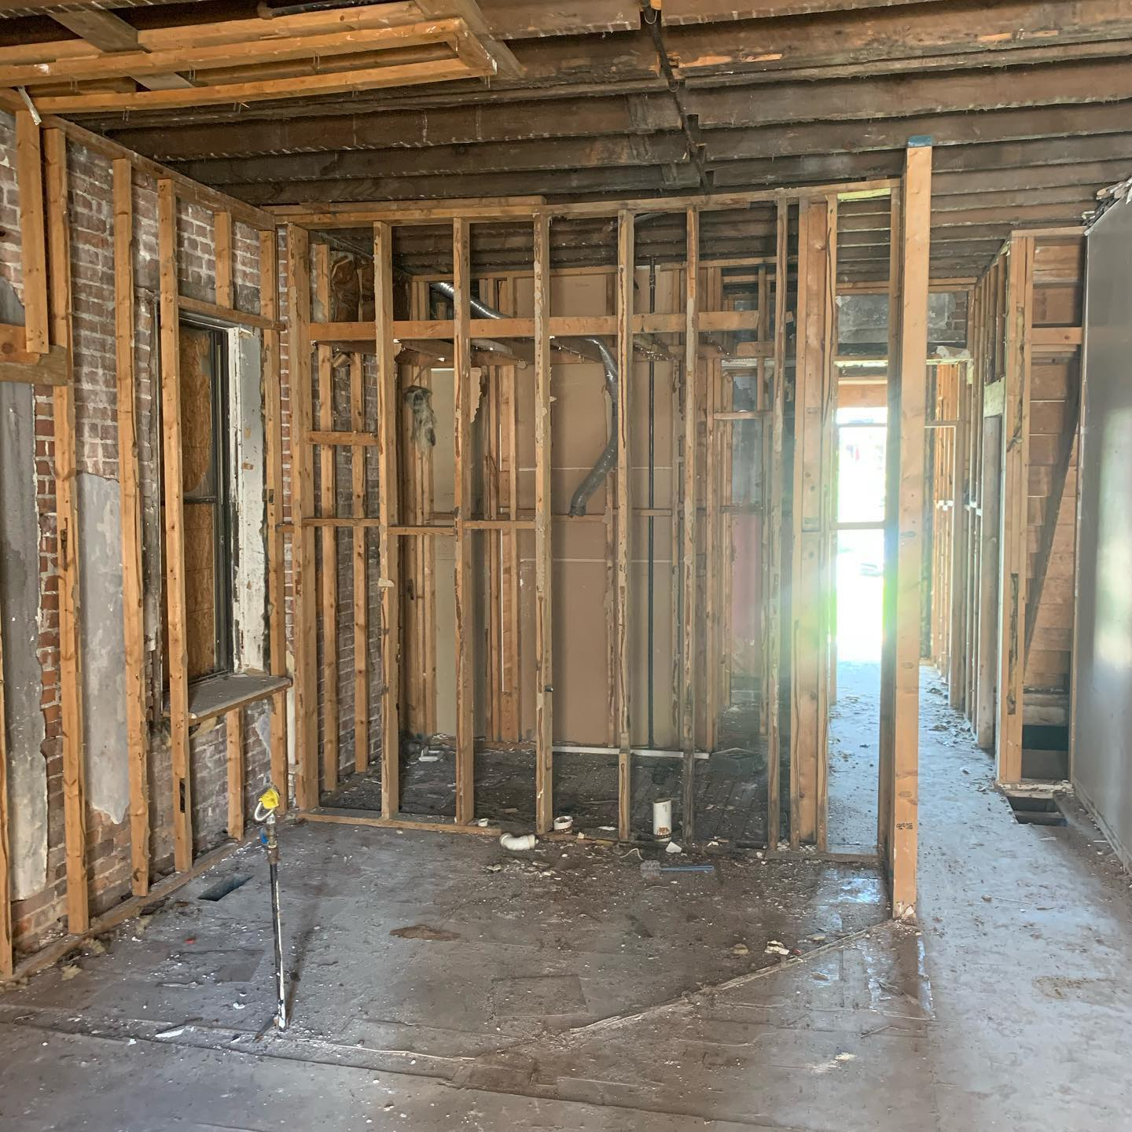
Mallinckrodt Properties – Home Ownership

Slide 23
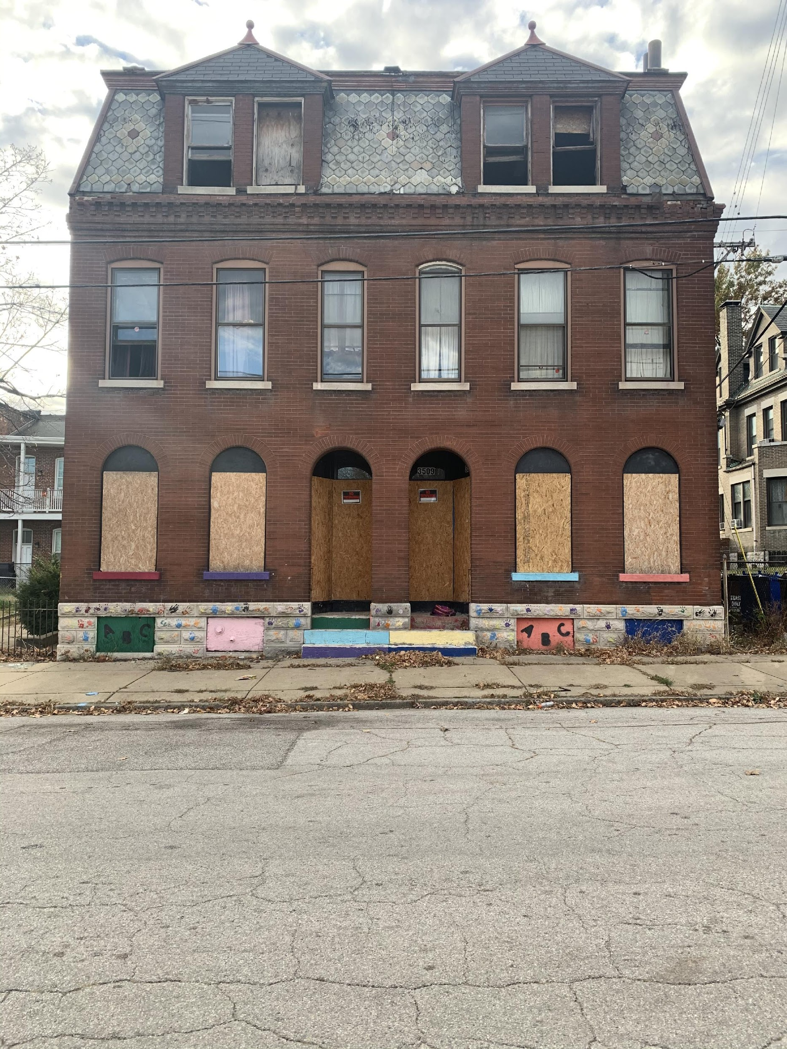
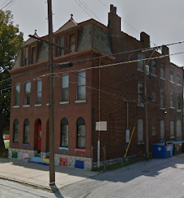
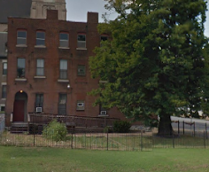
3509 N. 14th St. – Early Childhood Center
Services:
24hr. daycare, affordable housing, arts & literature workshops, tutoring, and chess classes

Slide 24
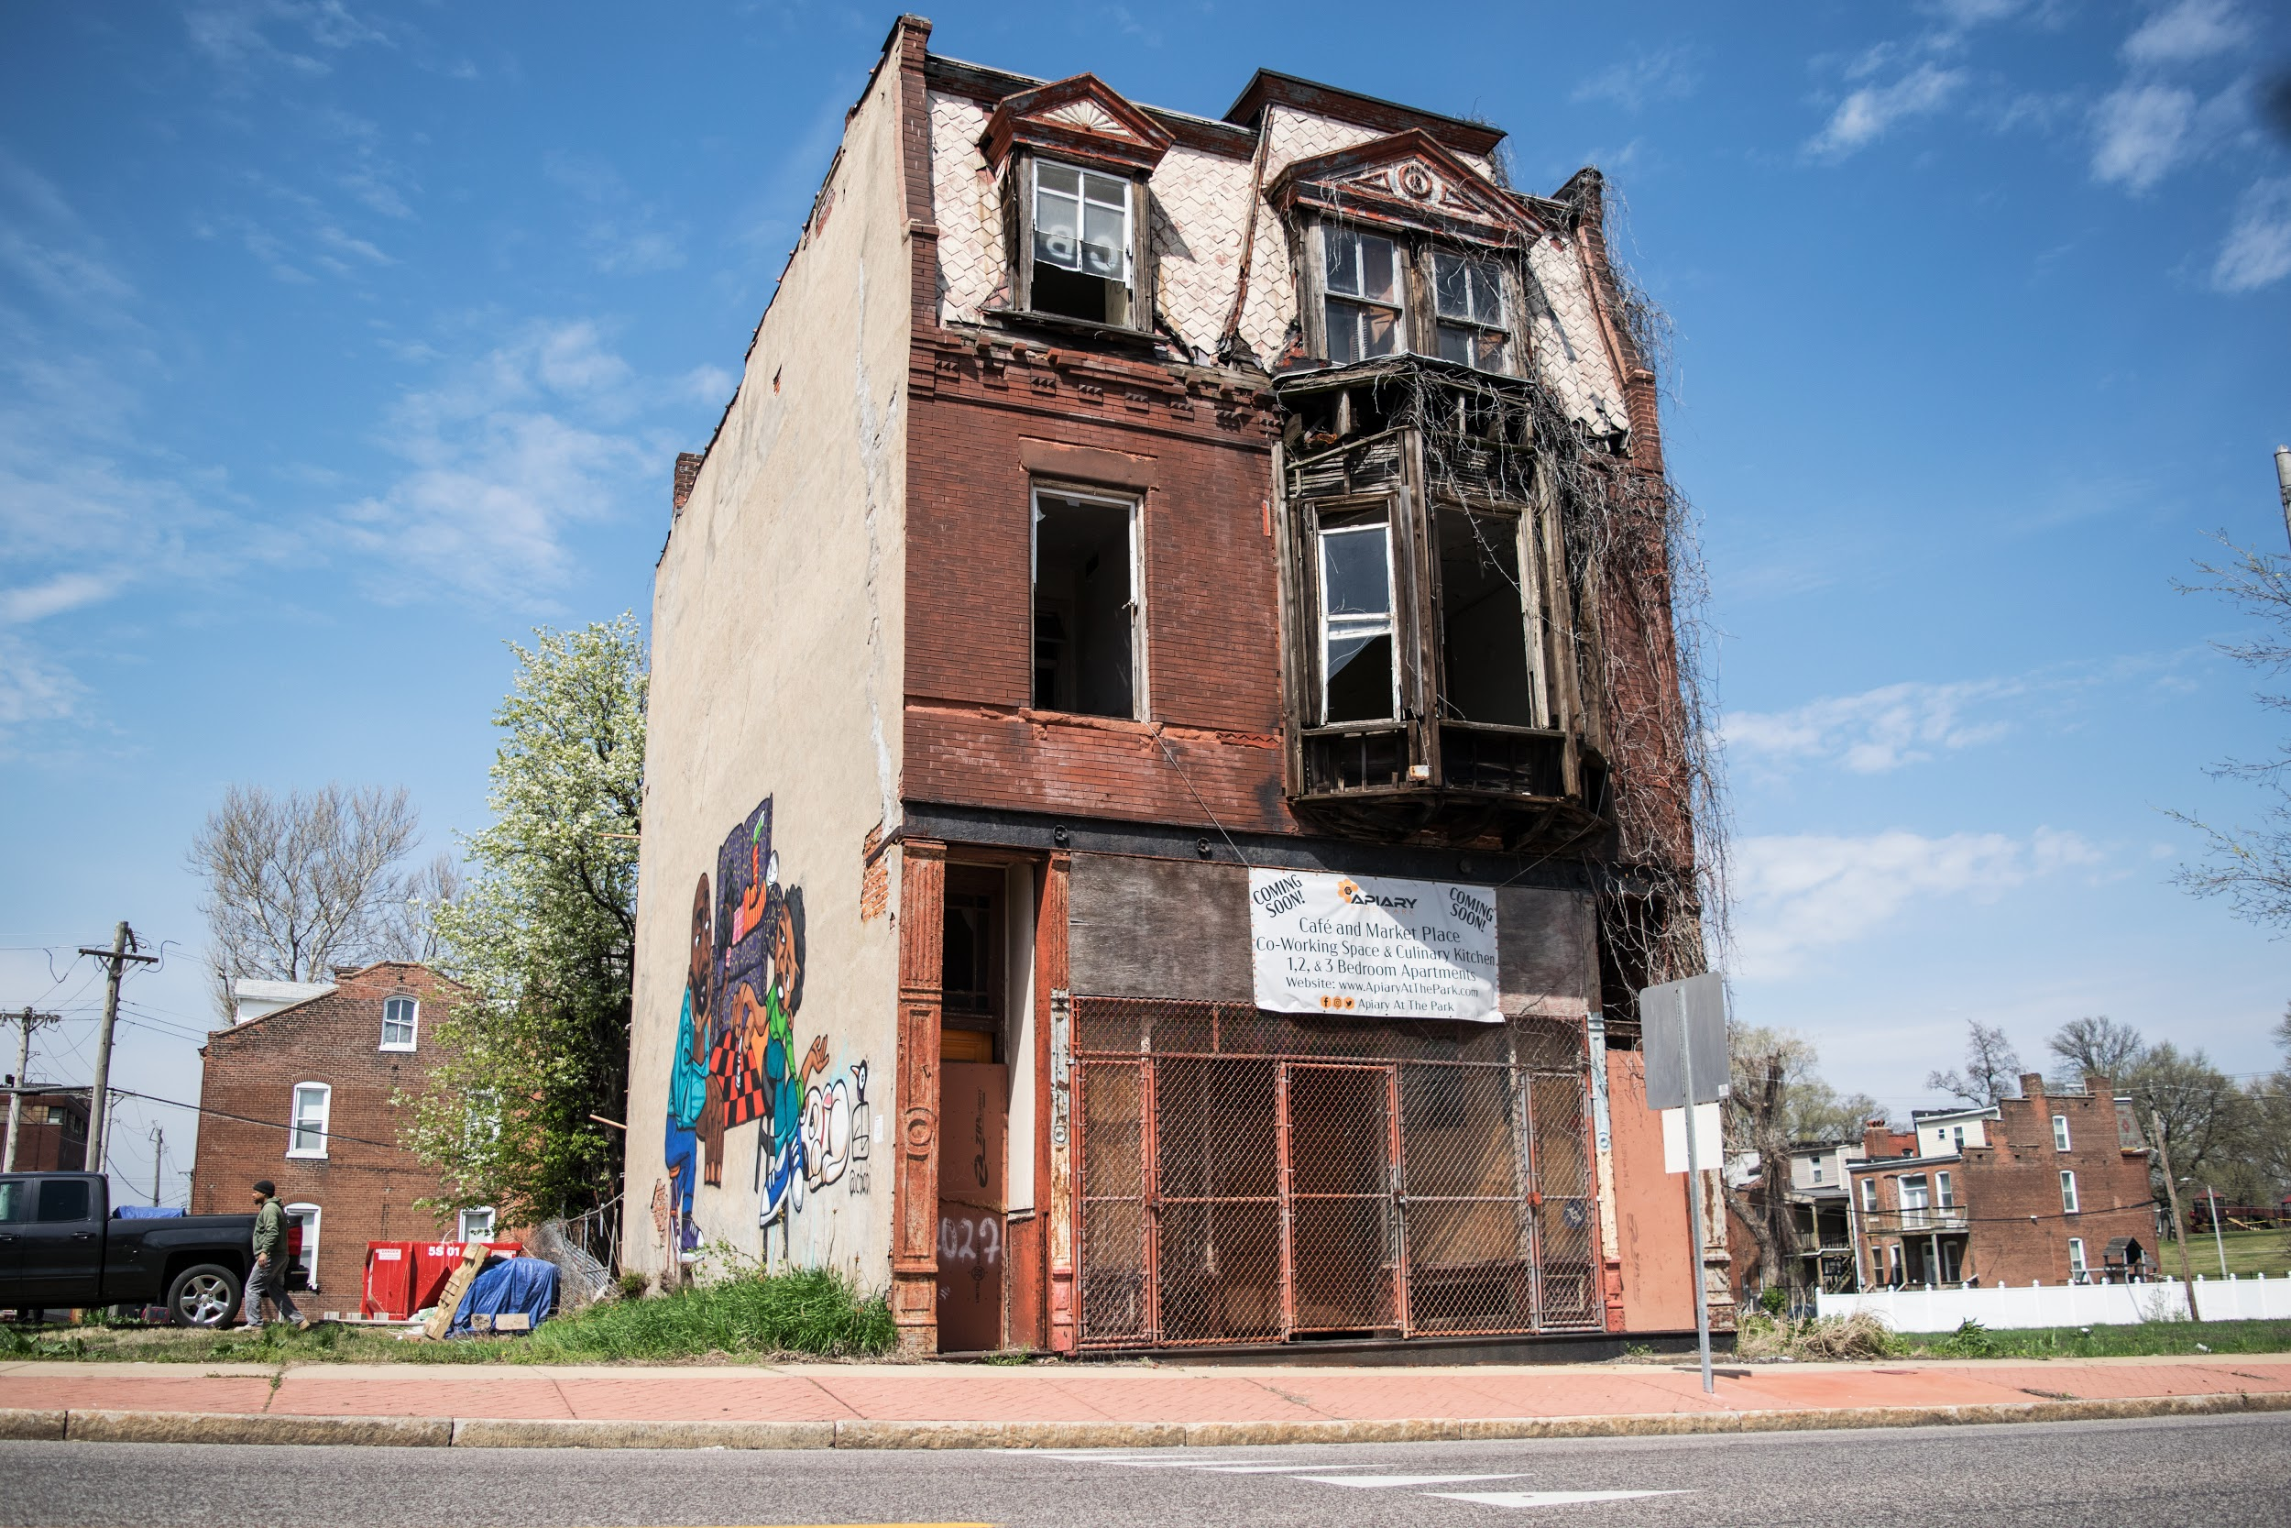
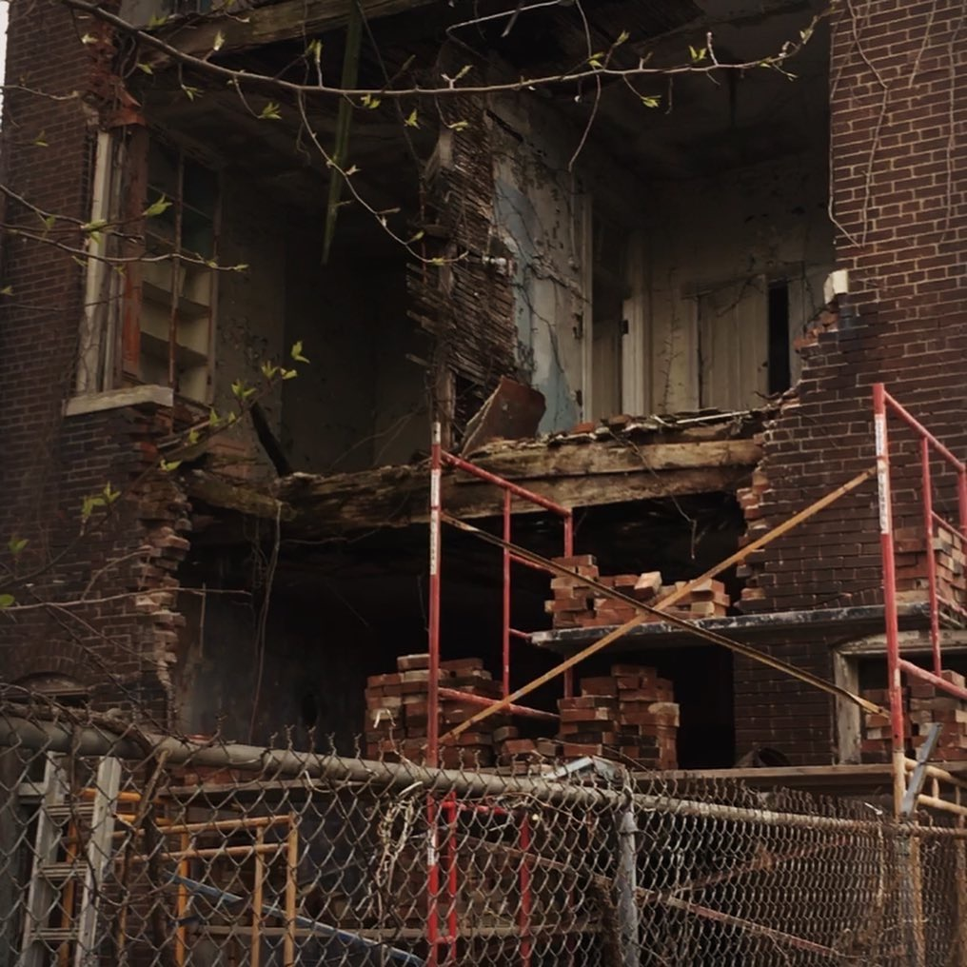
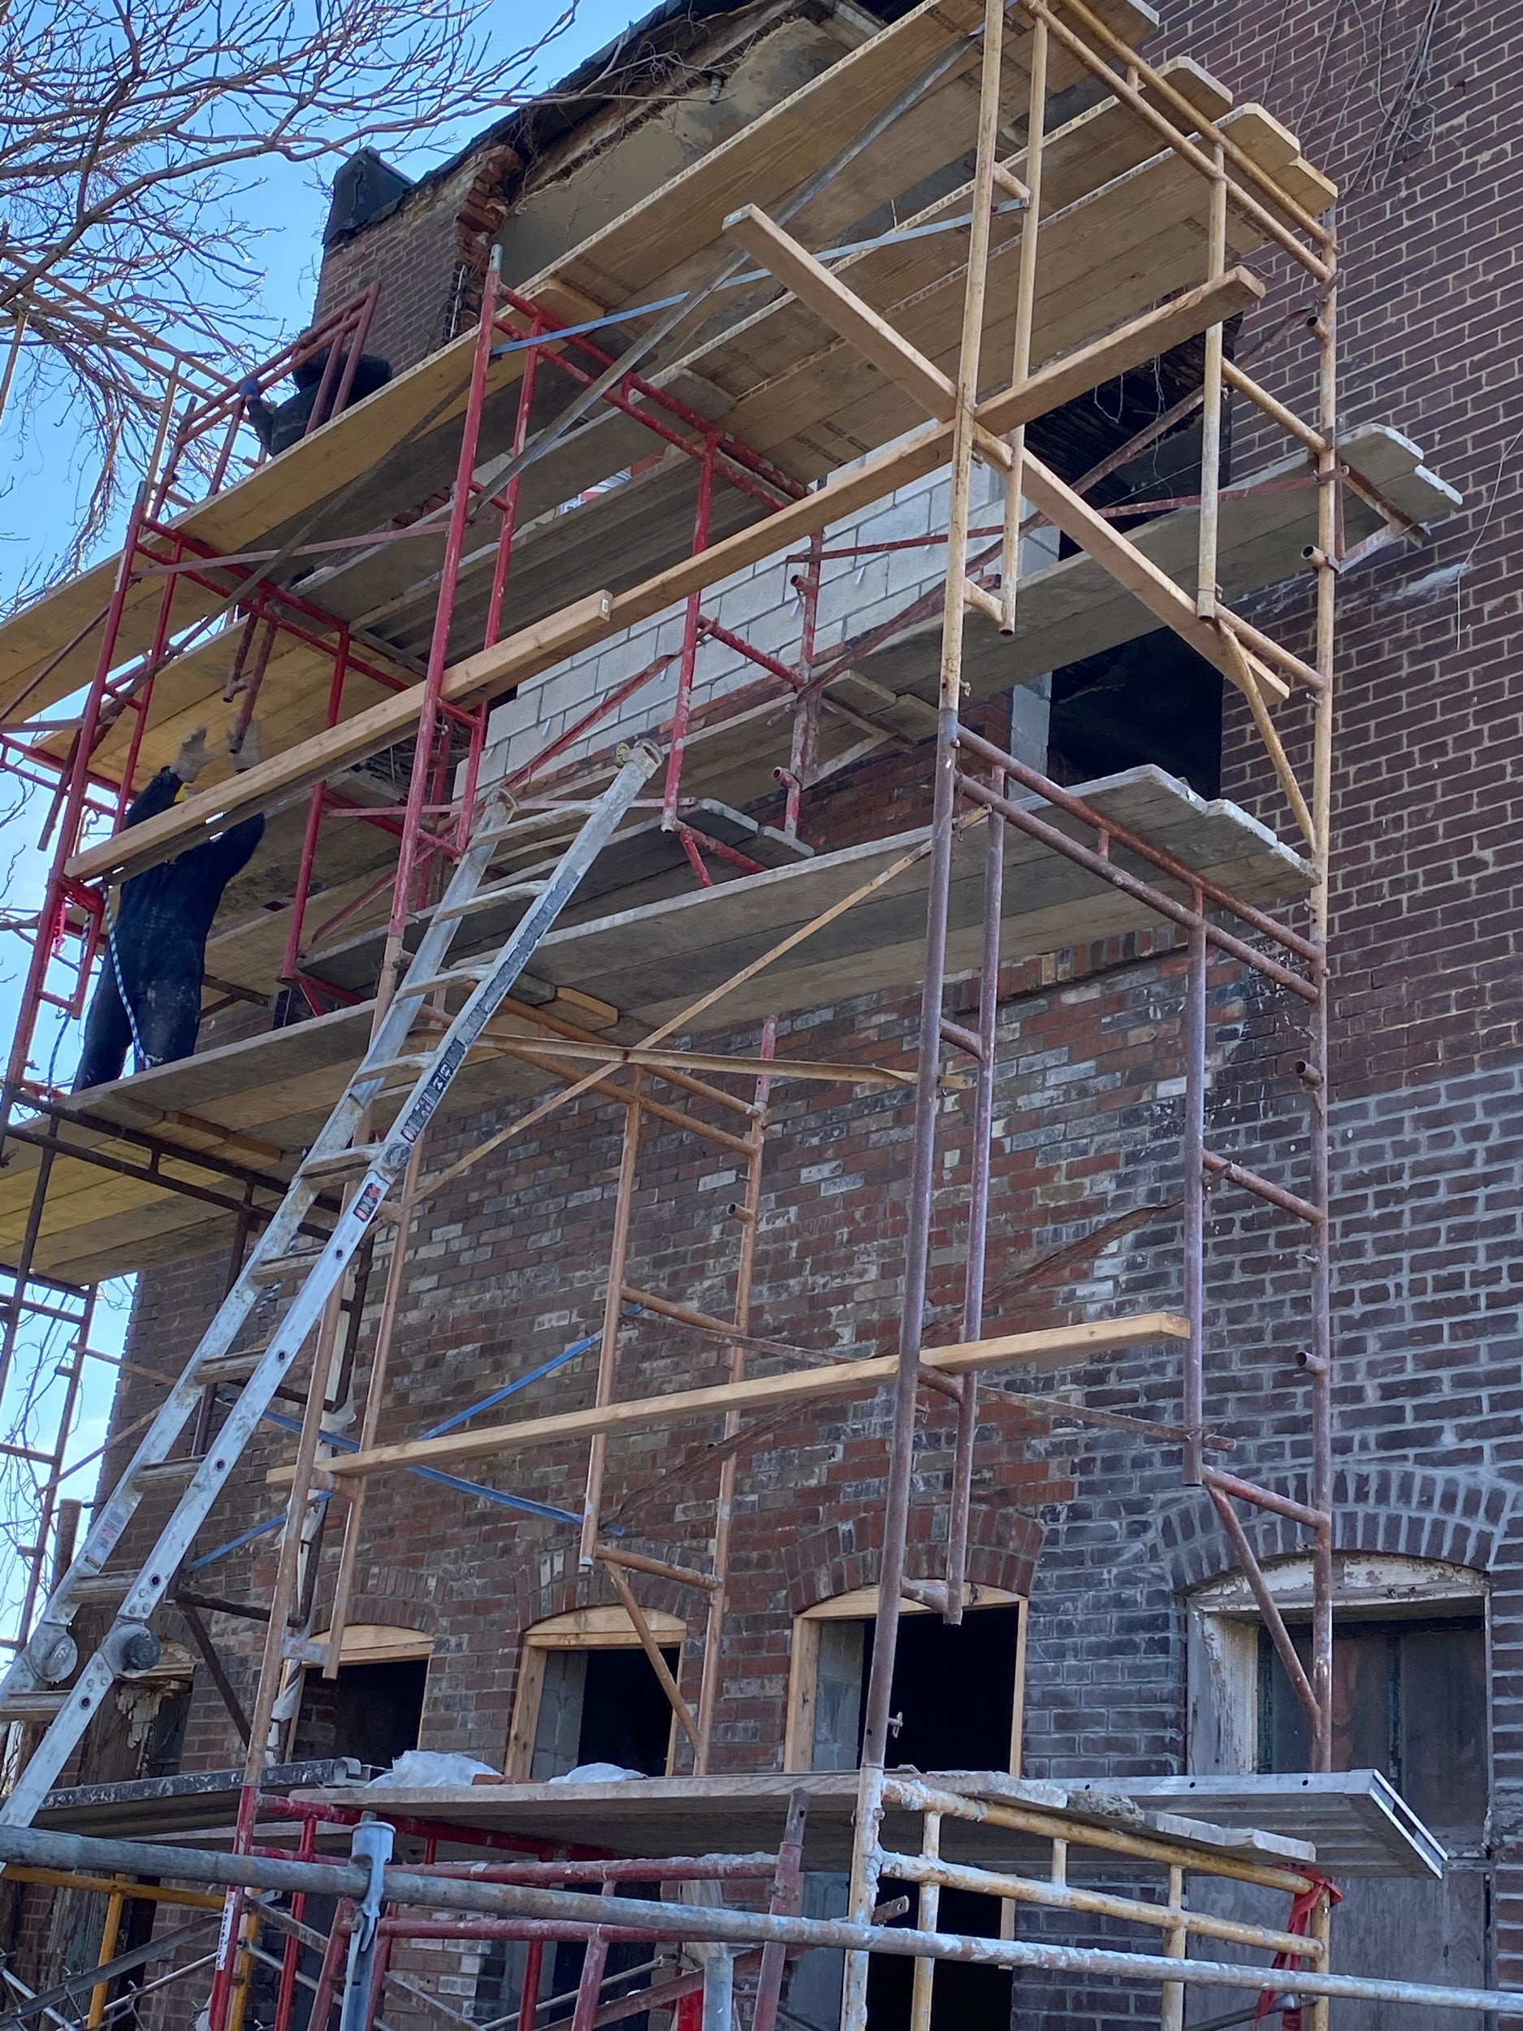
Apiary at the Park – Business Incubator

Slide 25
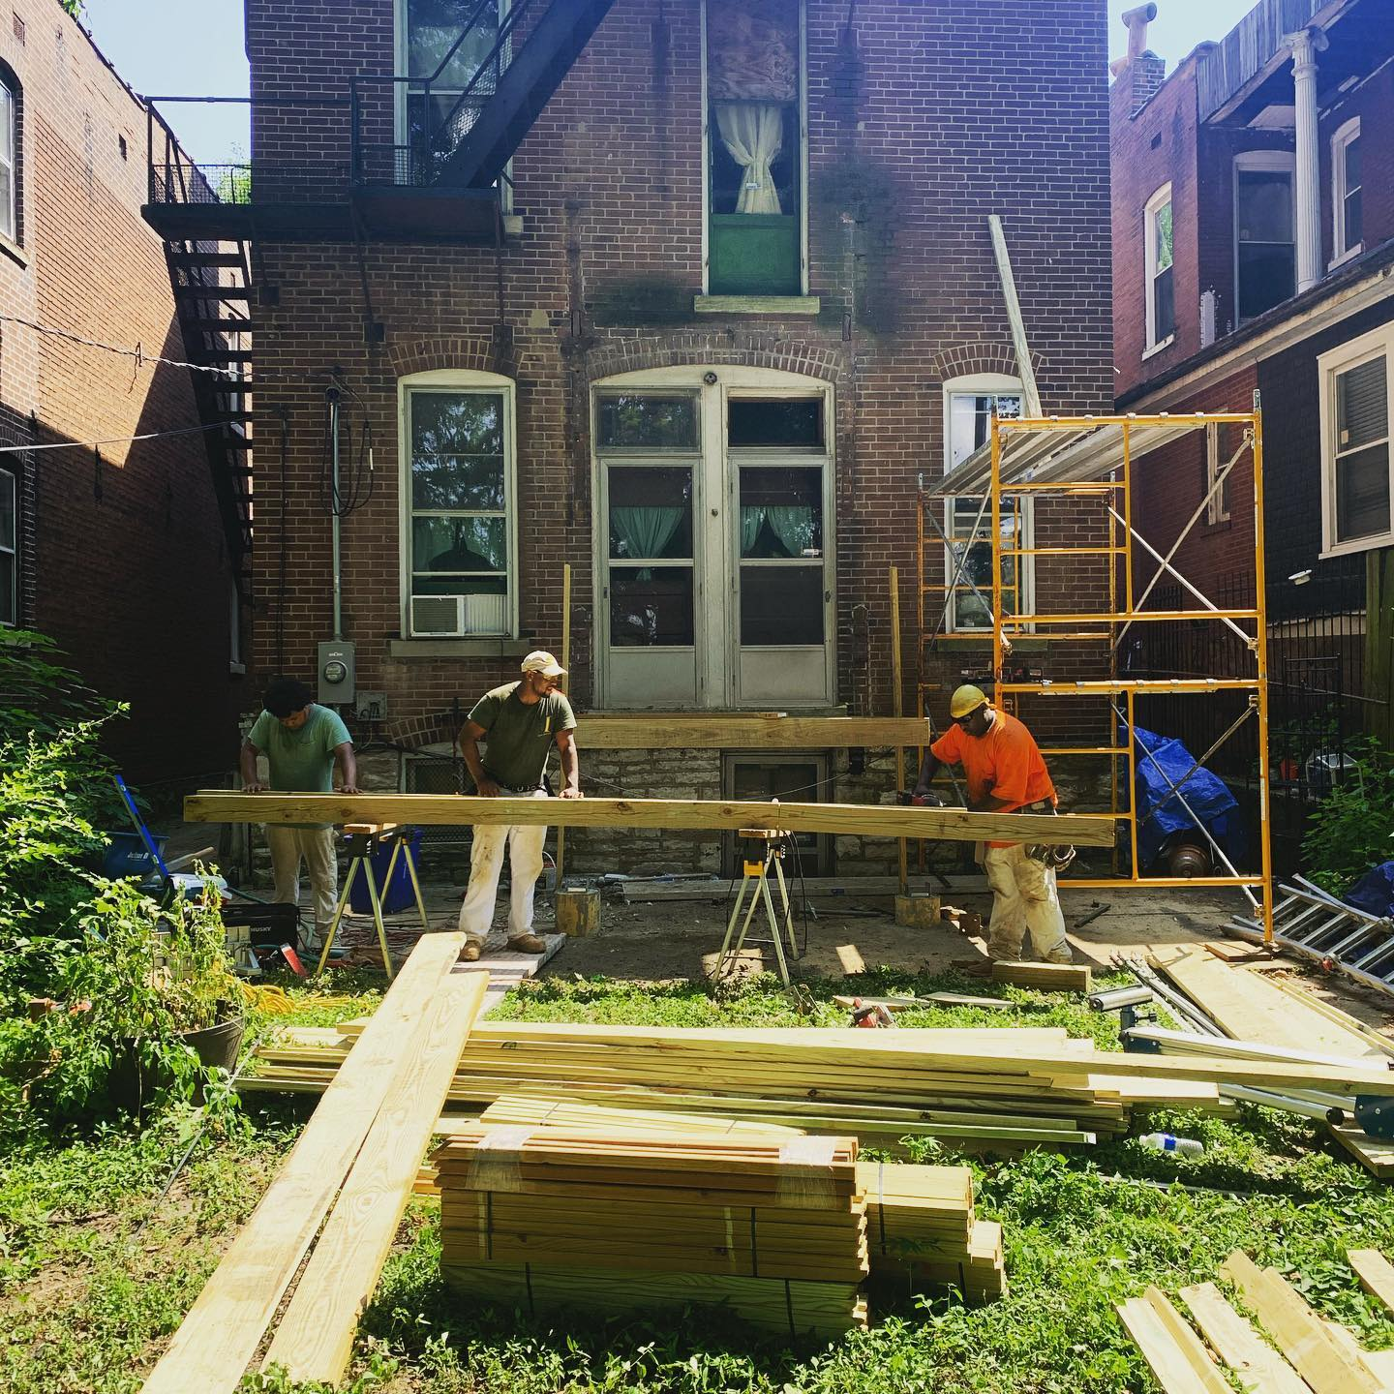
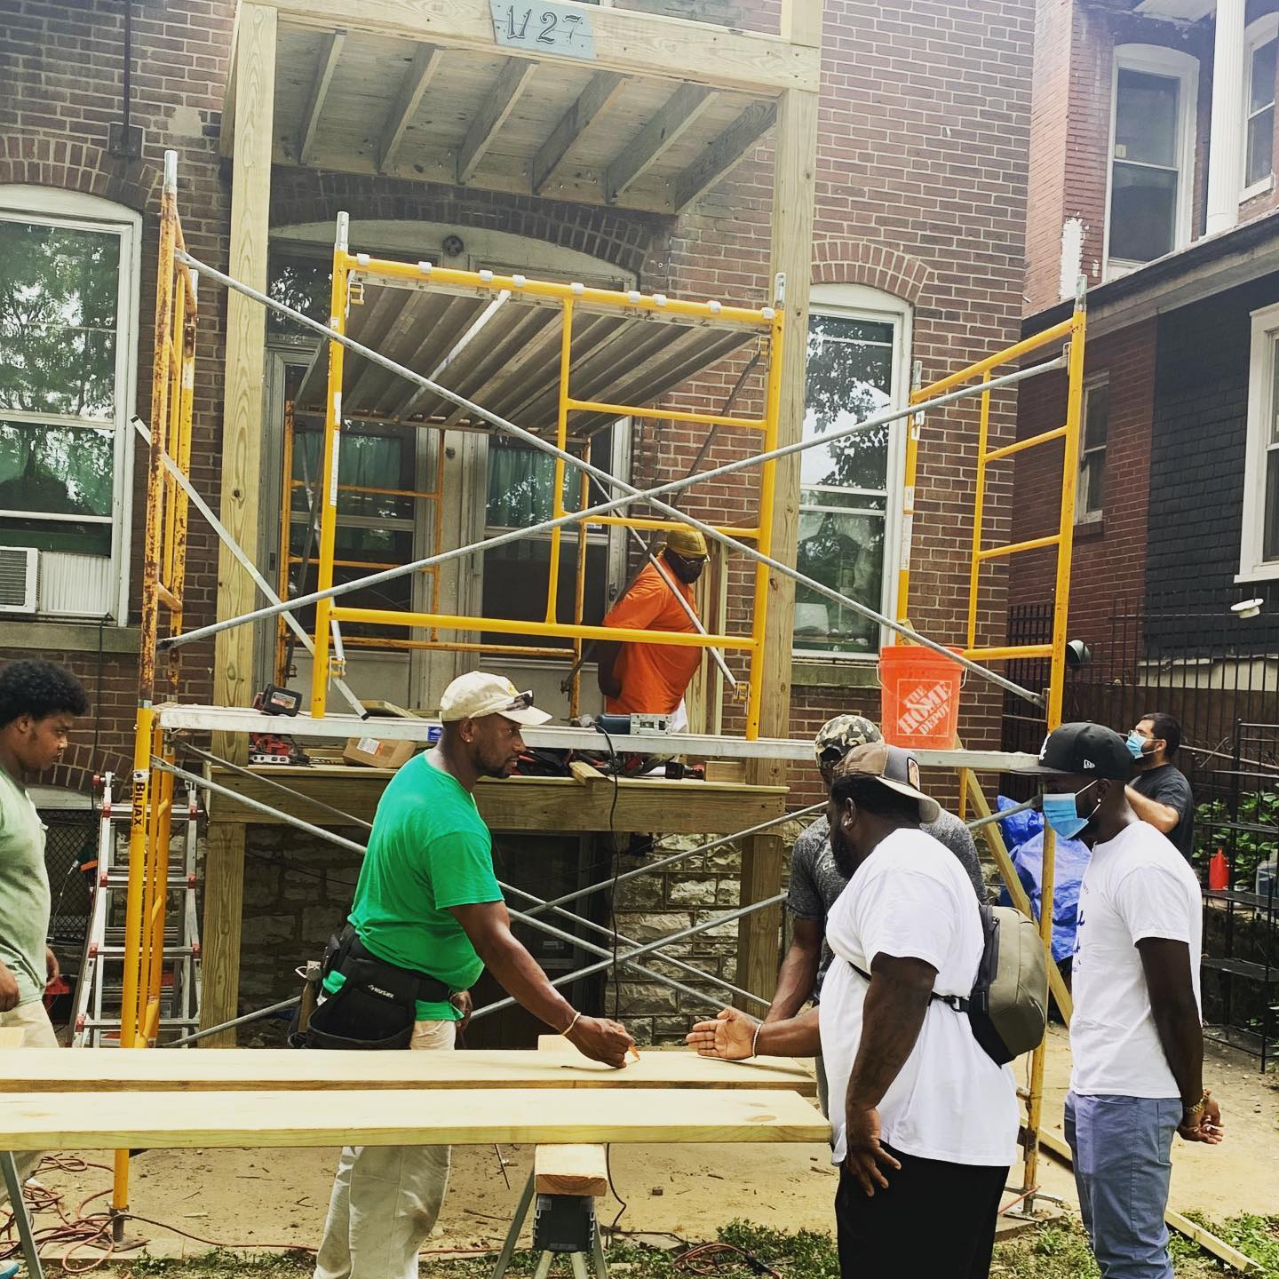
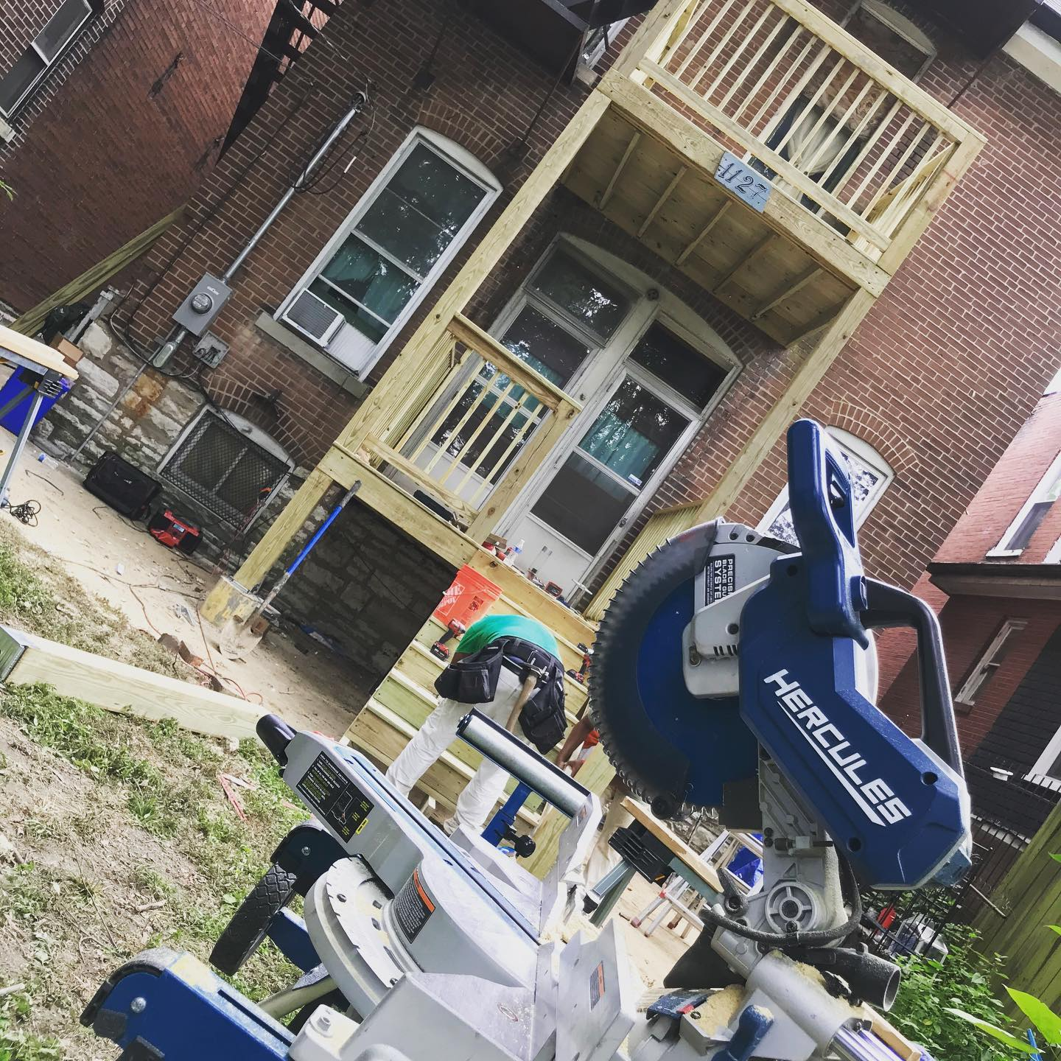



Major Home Repairs for Elders

Slide 26



Hyde Park Progress
Acquired 7 properties in the Hyde Park Neighborhood
DB4E hired to complete a rehab of a commercial building in Hyde Park
Provided free home repair projects for 10 elderly residents in Hyde Park
Provided free landscaping for 100 senior residents for three months
Hosted Neighborhood Cleanup and Toiletry Giveaway in Hyde Park
Rehabbing 9 vacant properties

Slide 27



Dream Builders Chess Park

Slide 28
www.dreambuilders4equity.org

